Slide 1
Artist Generation (Select examples)
Brian Henriquez

Slide 2
Generation Procedure
Generate quotes from popular source using char-RNN.
Restrict ill-formatted quotes from generation
Unknown Author ➔ No Author was generated
Perform sentiment analysis on quotes to get “mood”
Based on dictionary trained on simple corpus.
Note: Unknown words were converted into spaces
Perform generation of base images using AttnGAN
Note: Network was trained on the COCO dataset
Given “mood” and base image, convert image to a select style using Neural Network Style Transfer.

Slide 3
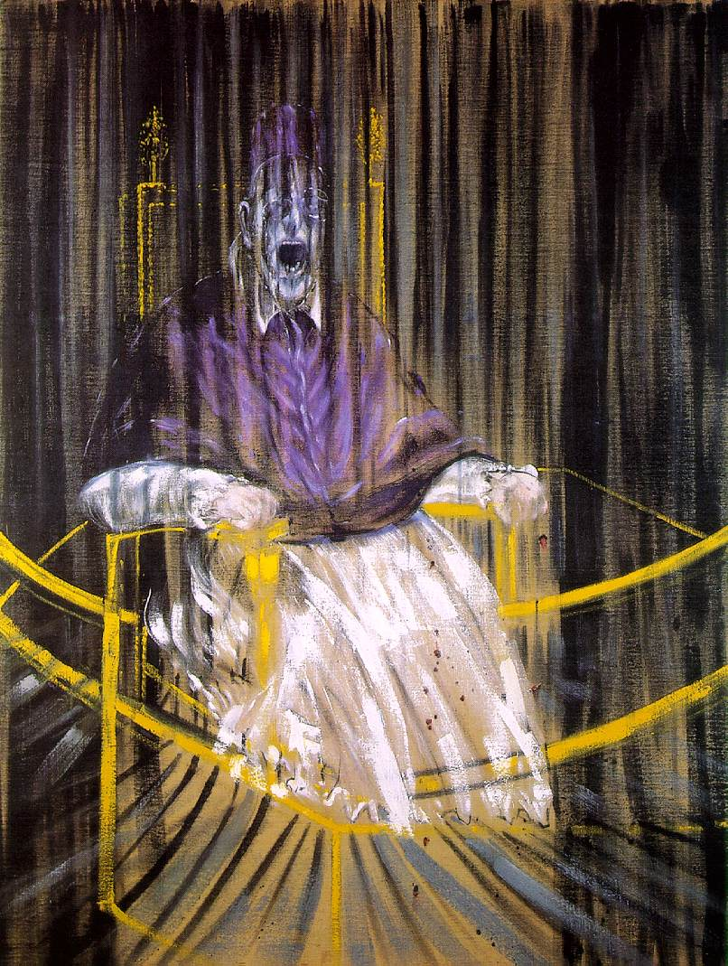
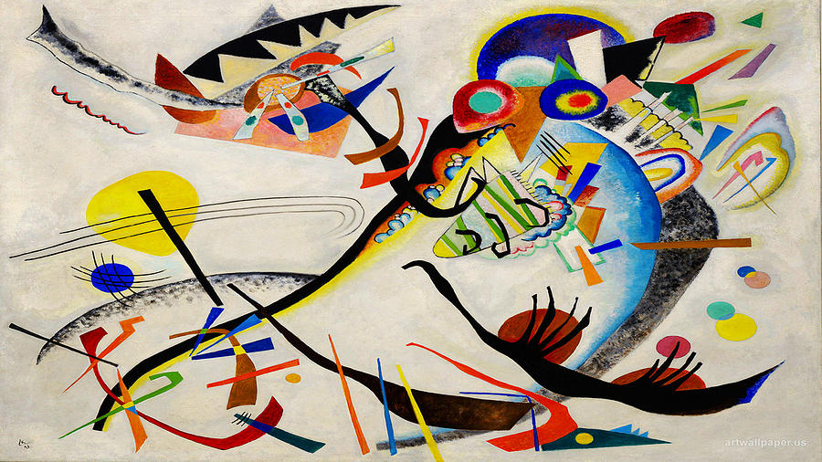
Seed Styles
The Bird
Wassily Kandinsky (1923)
Study after Velázquez's Portrait of Pope Innocent X
Francis Bacon (1953)

Slide 4
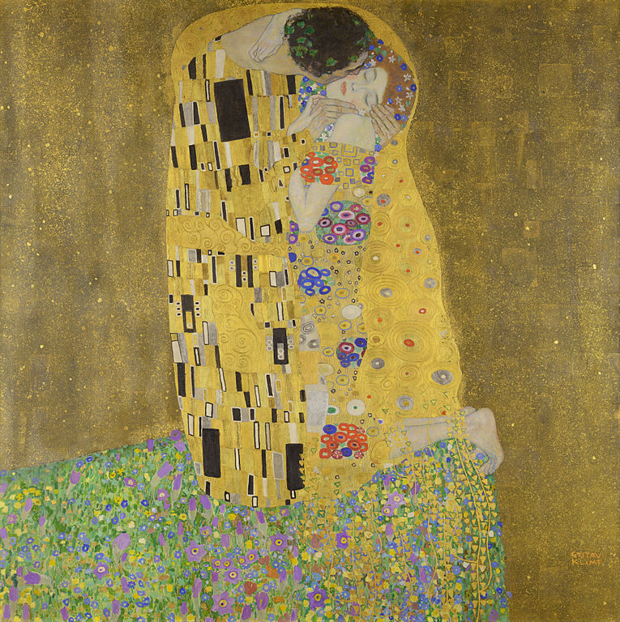
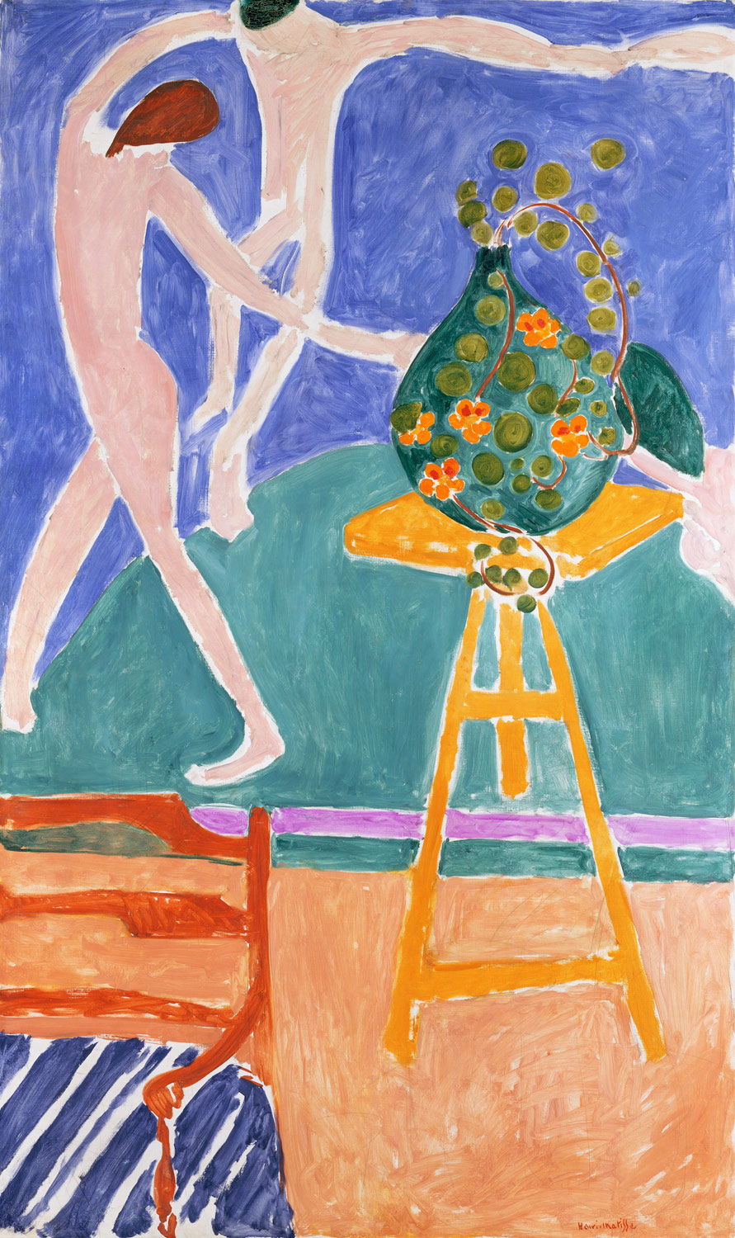
Seed Styles
The Kiss
Gustav Klimt (1907-1908)
Capucines à La Danse I
Henri Matisse (1910-1912)

Slide 5
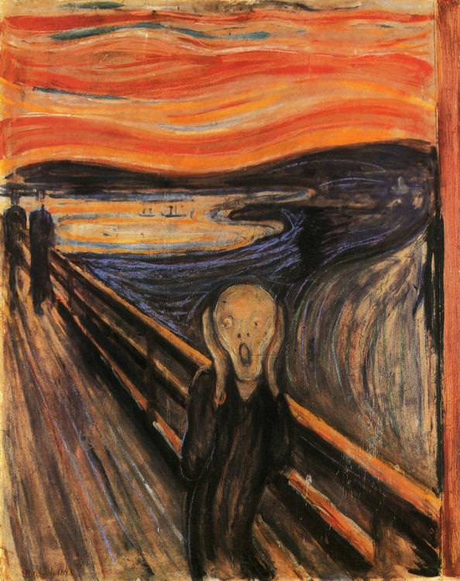
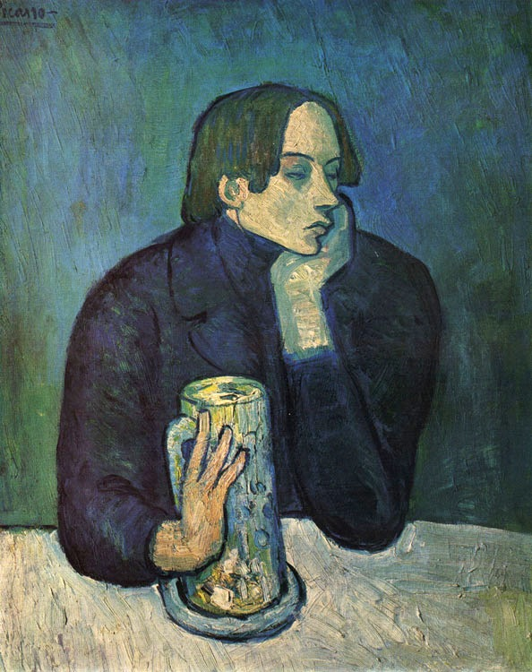
Seed Styles
The Scream
Edvard Munch (1893)
Portrait of Jaime Sabartes
Pablo Picasso (1901)

Slide 6
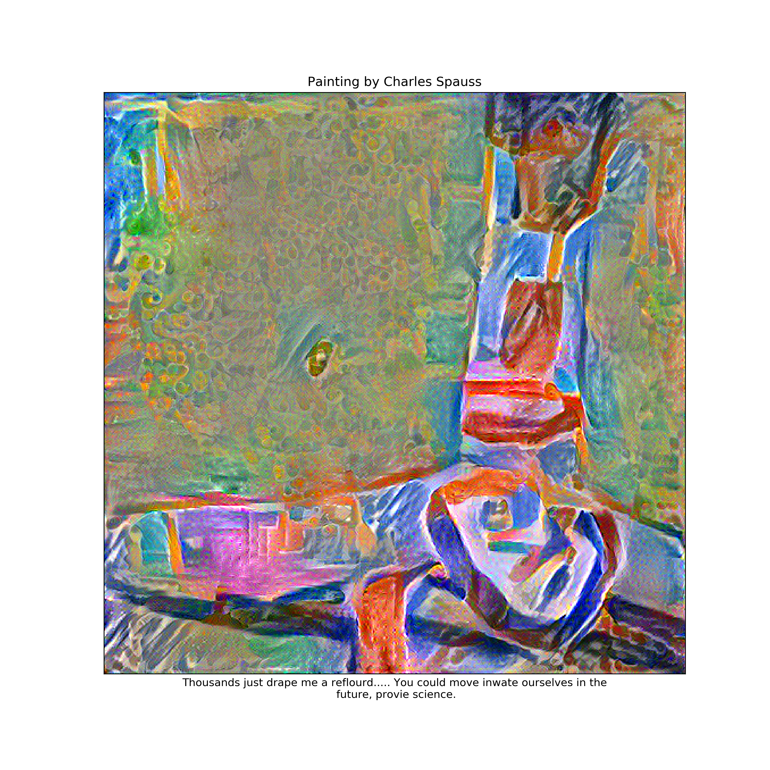

Slide 7
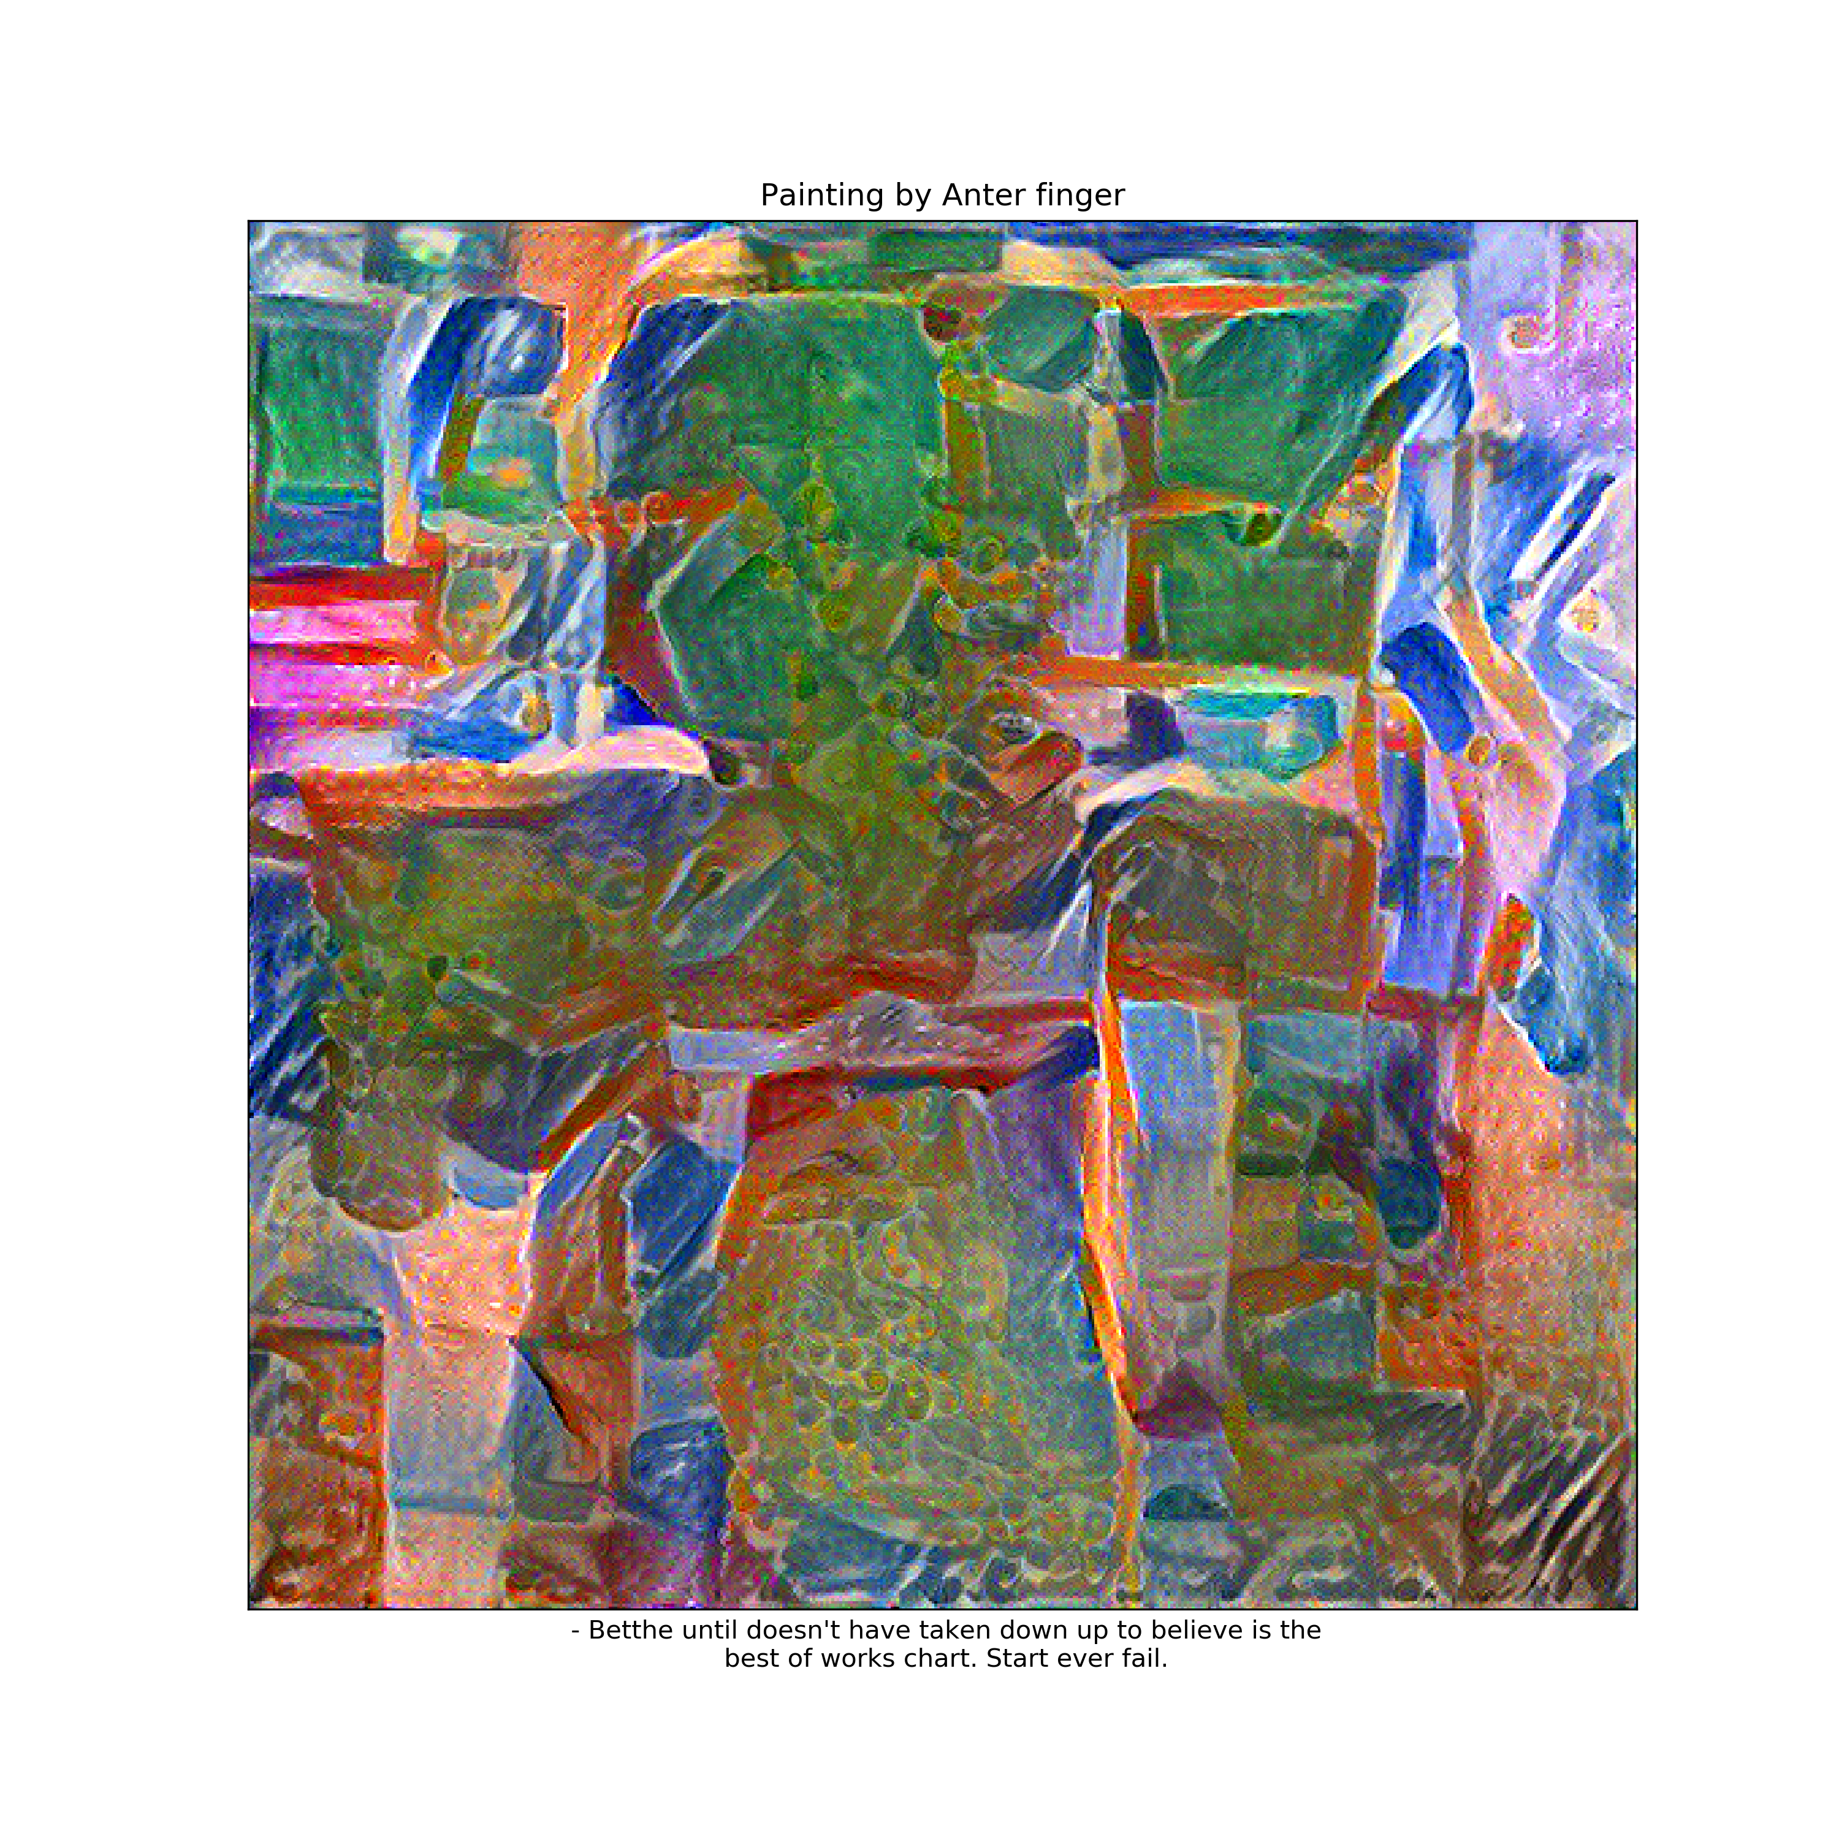

Slide 8
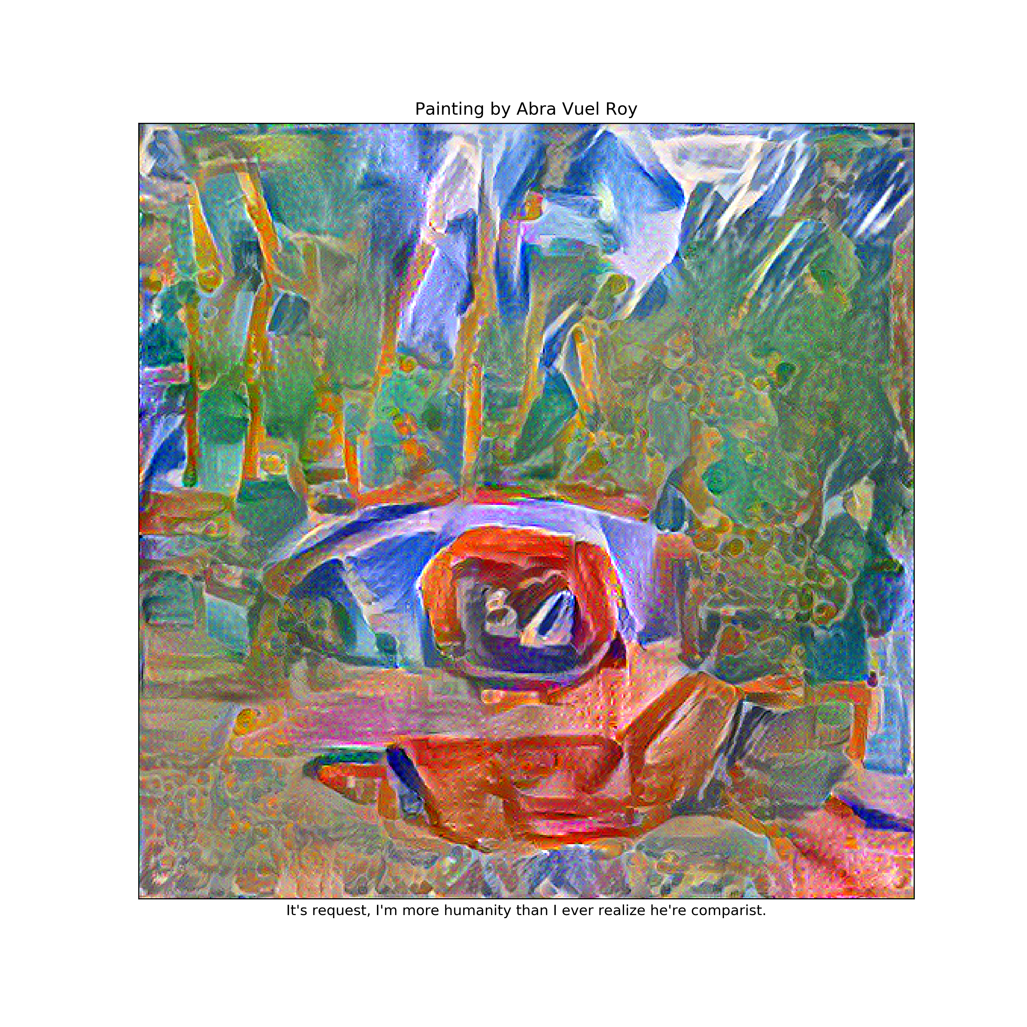

Slide 9
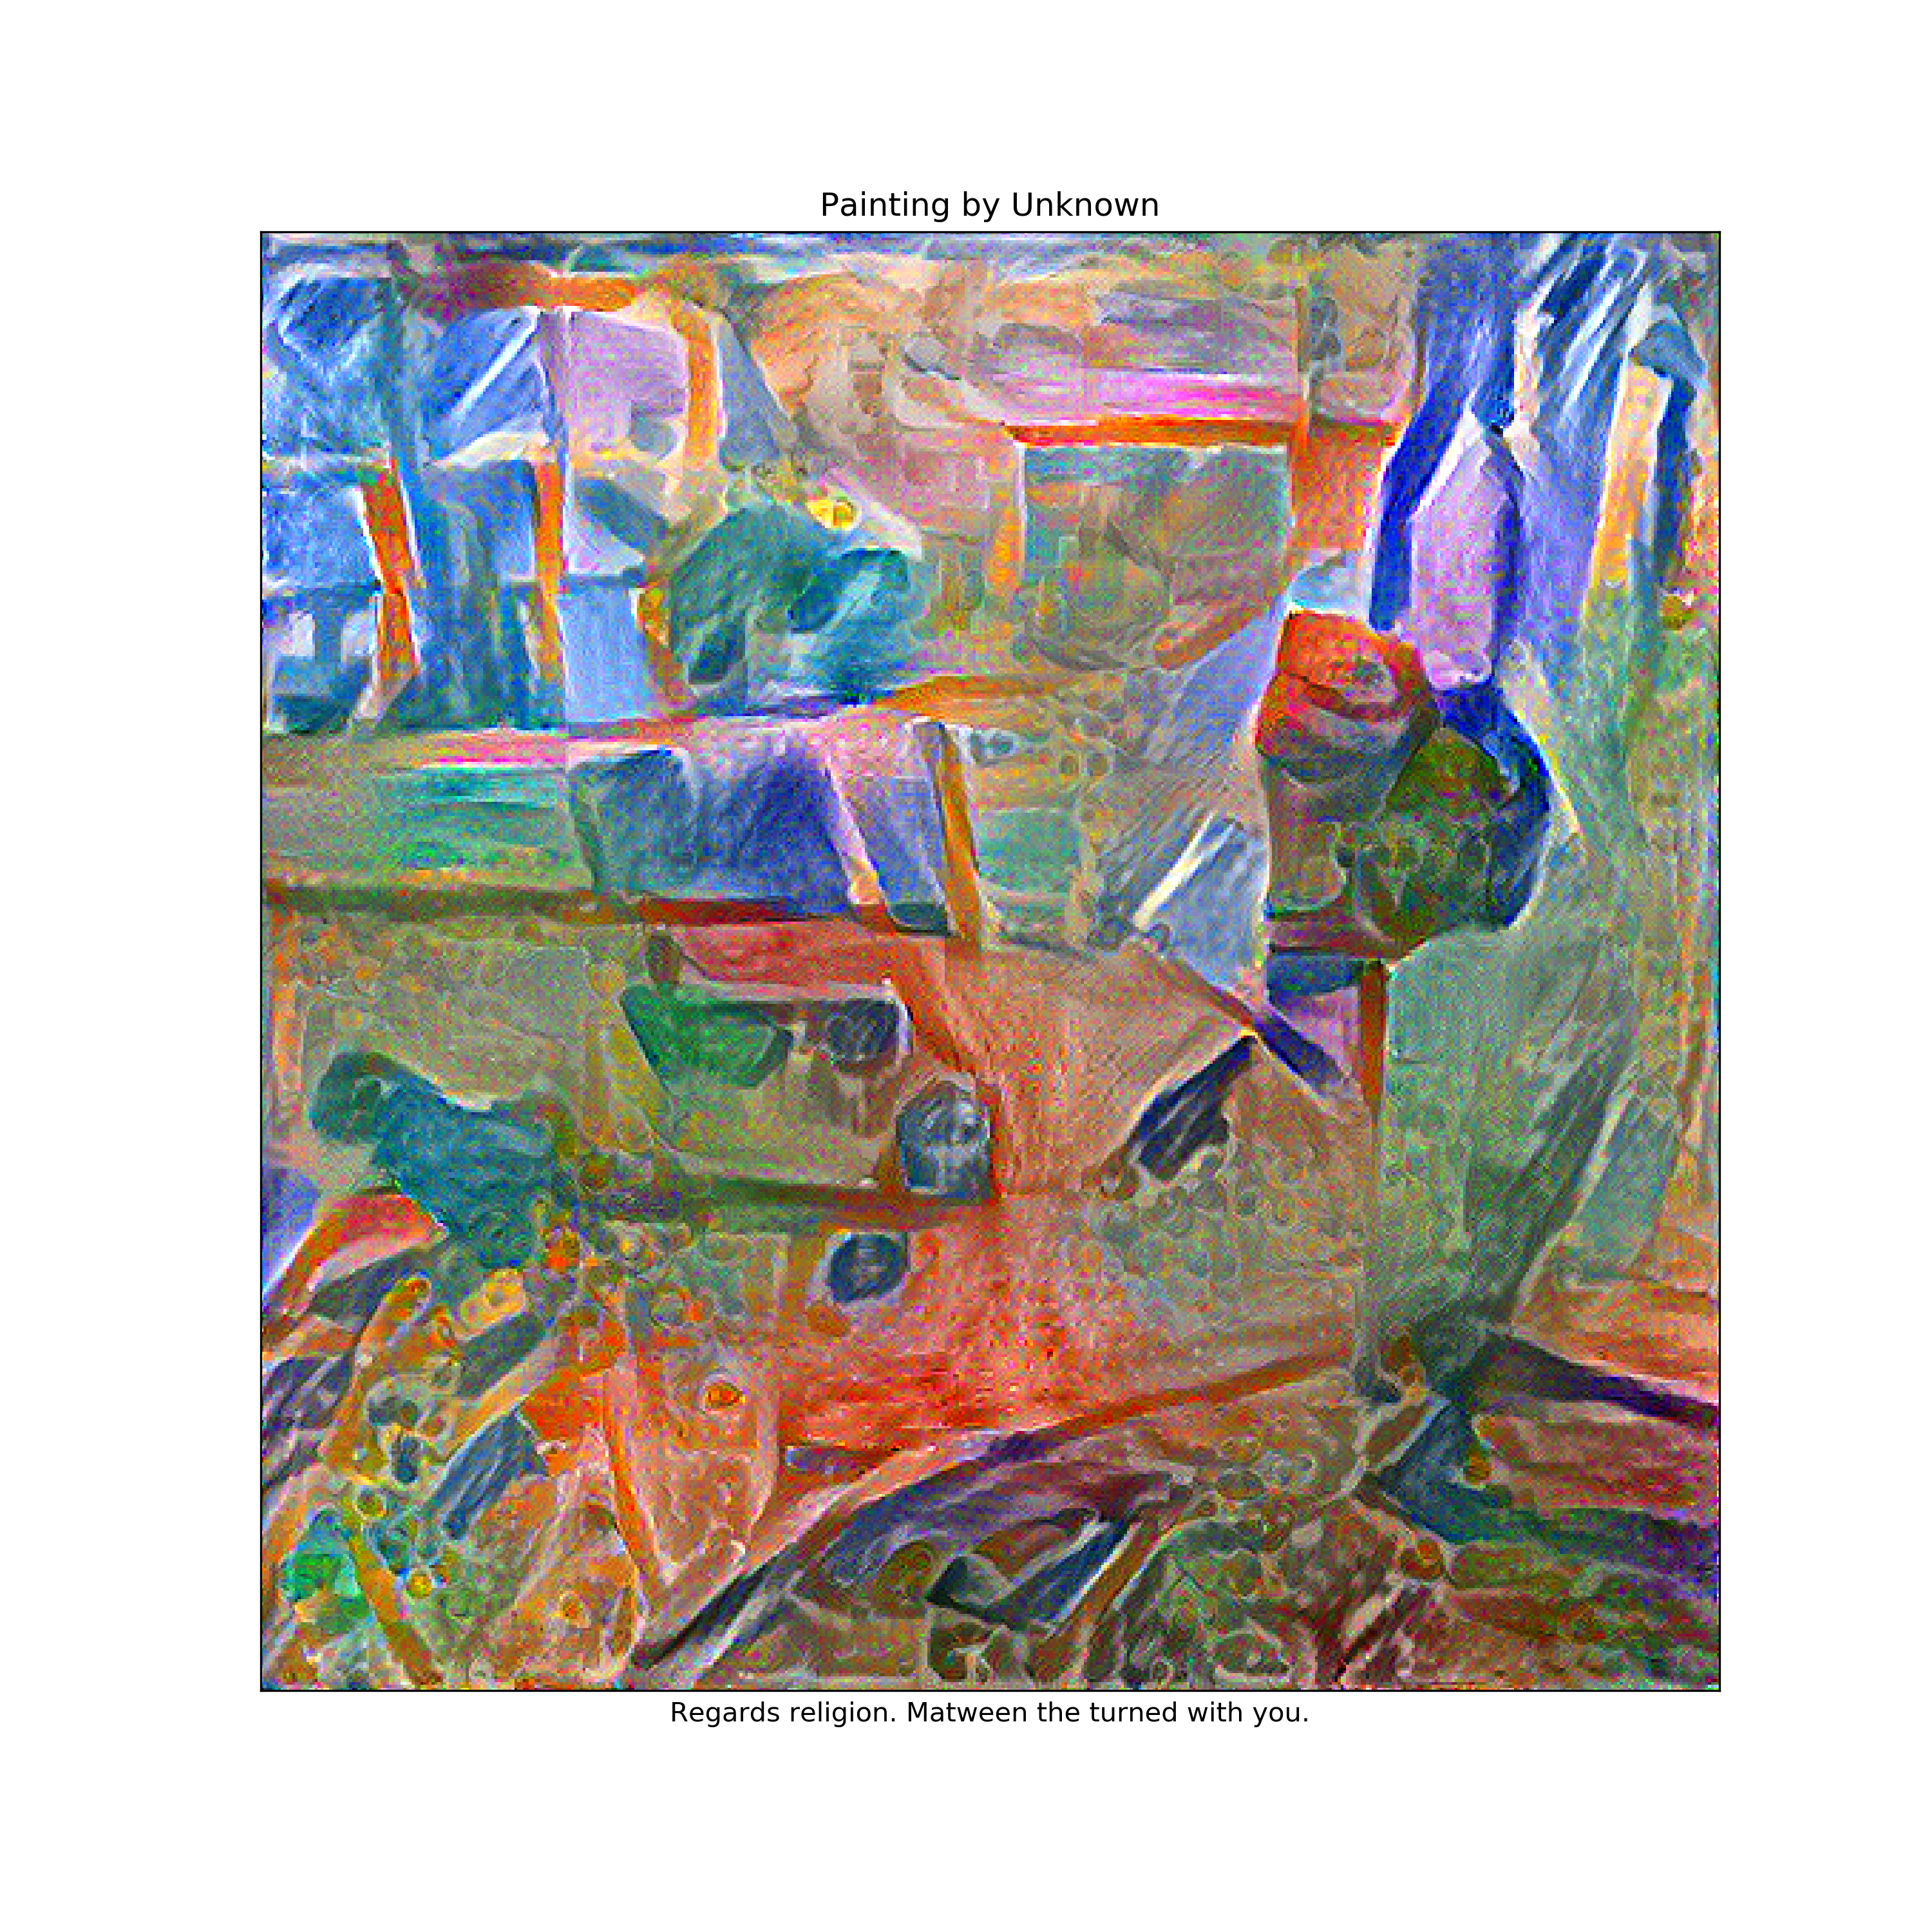

Slide 10
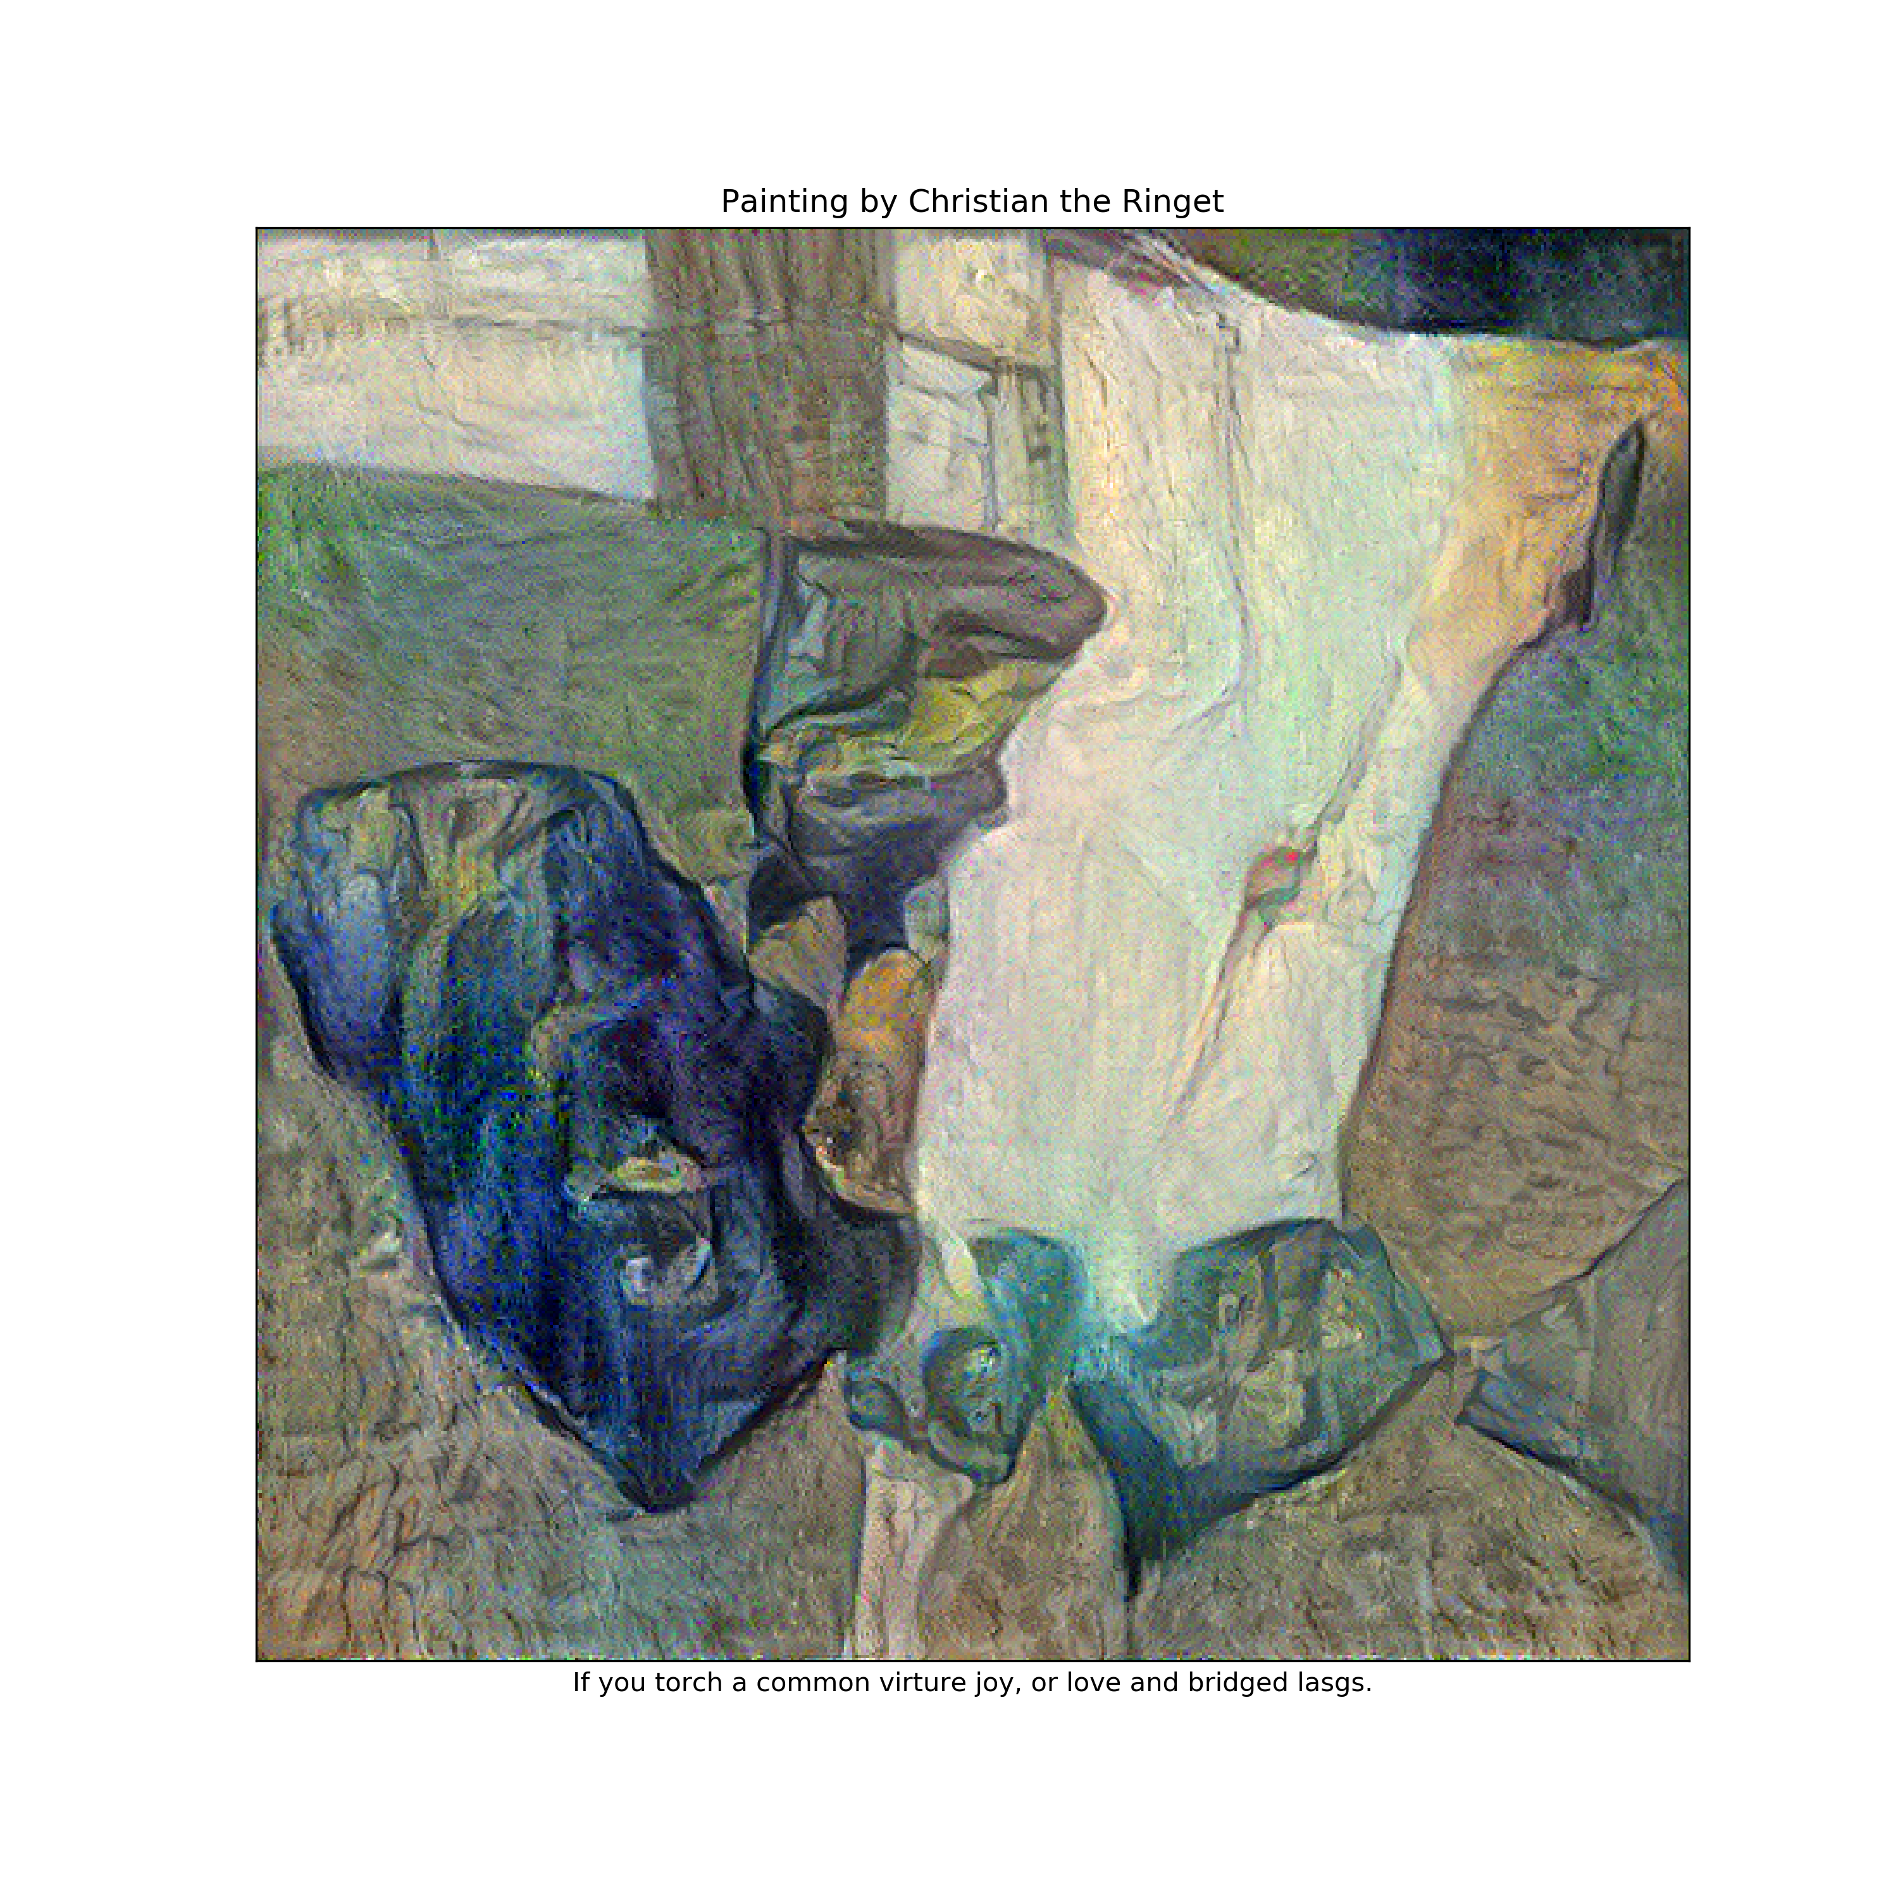

Slide 11
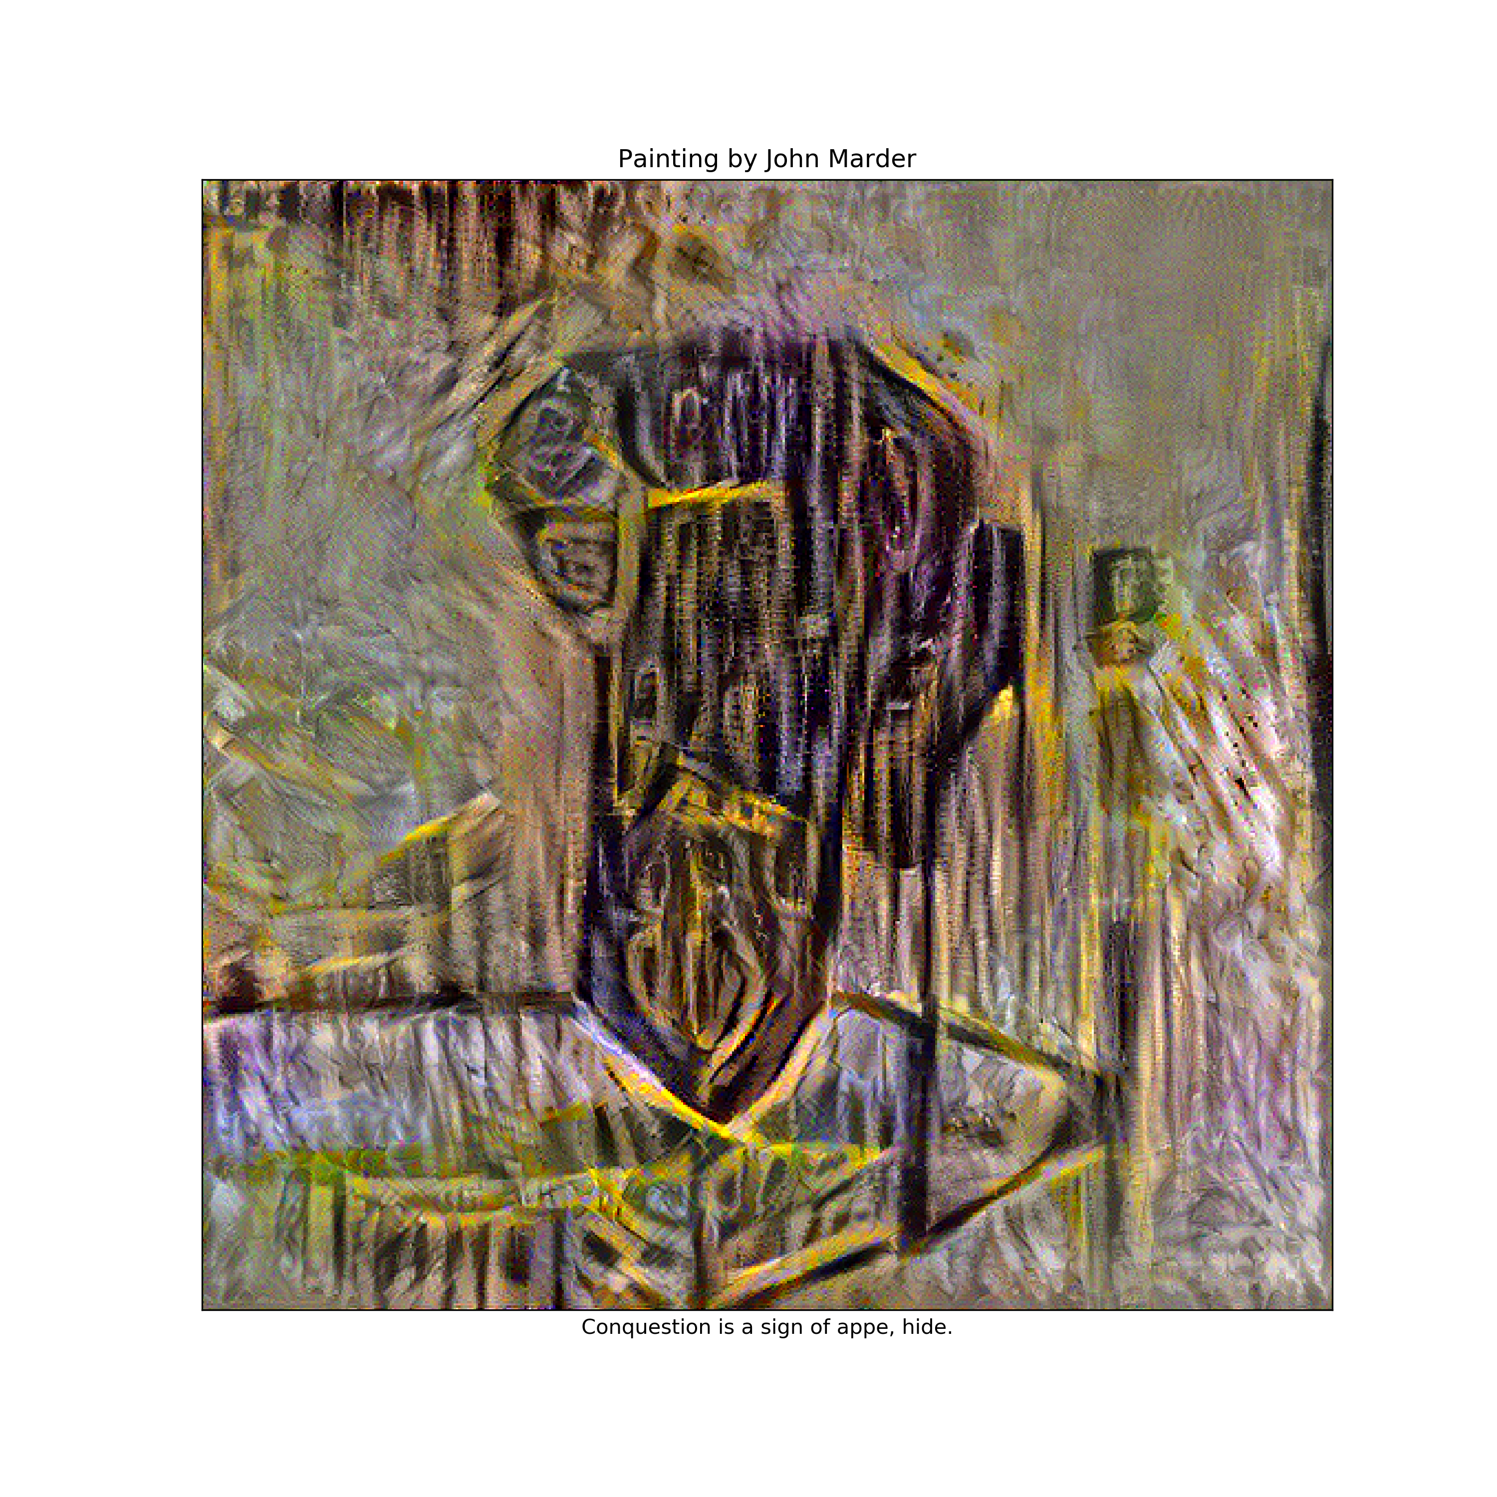

Slide 12
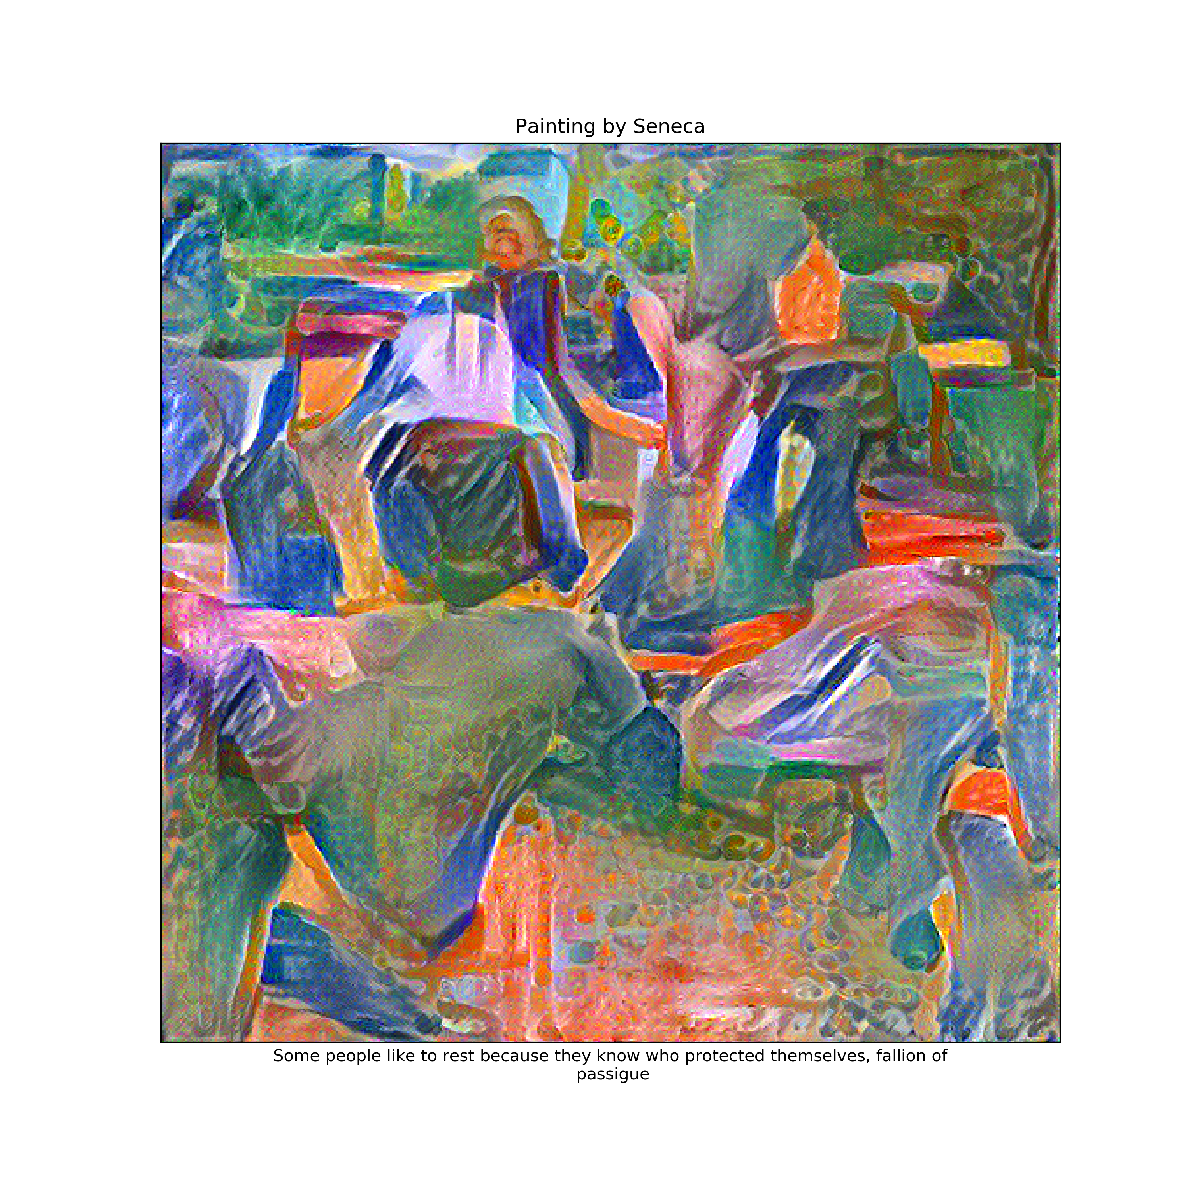

Slide 13
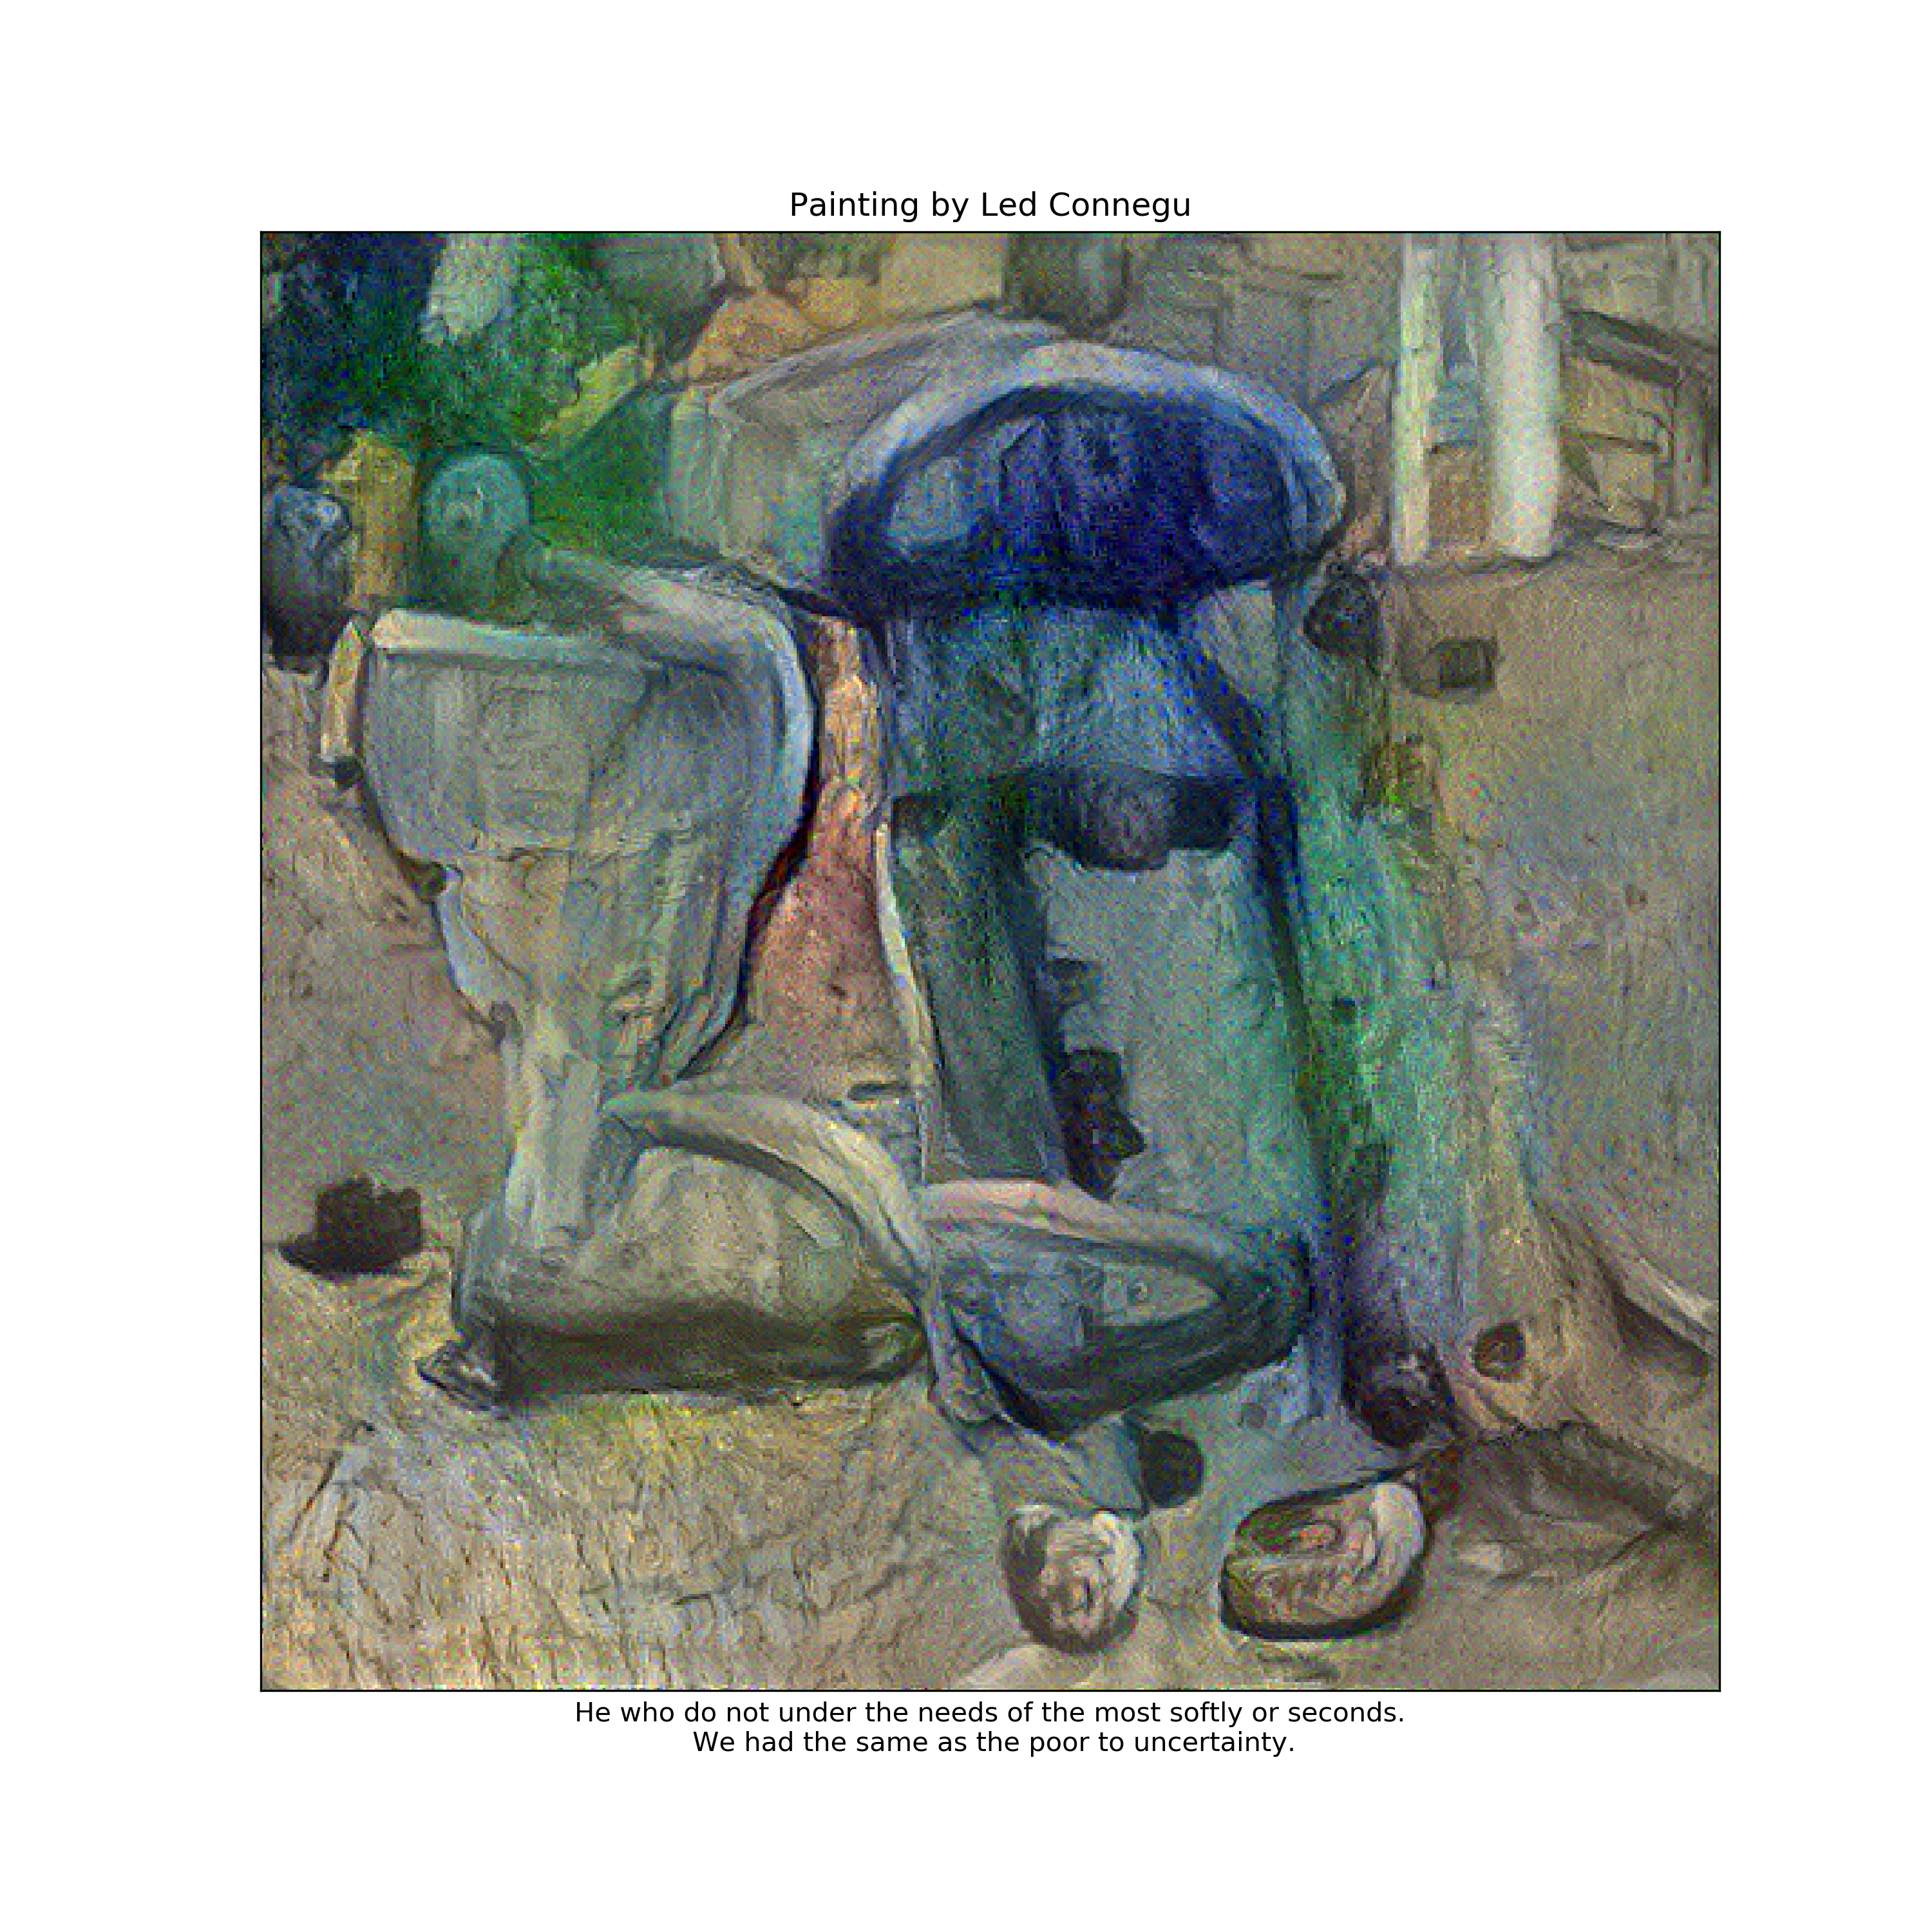

Slide 14
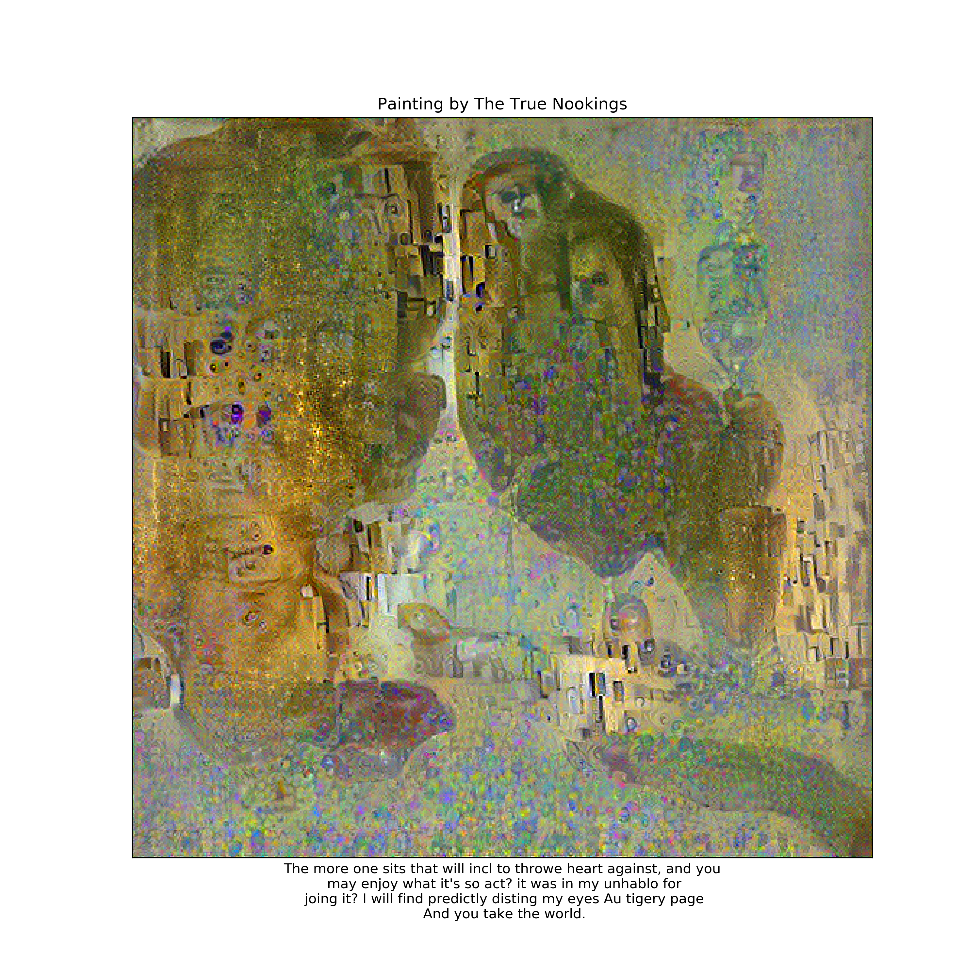

Slide 15
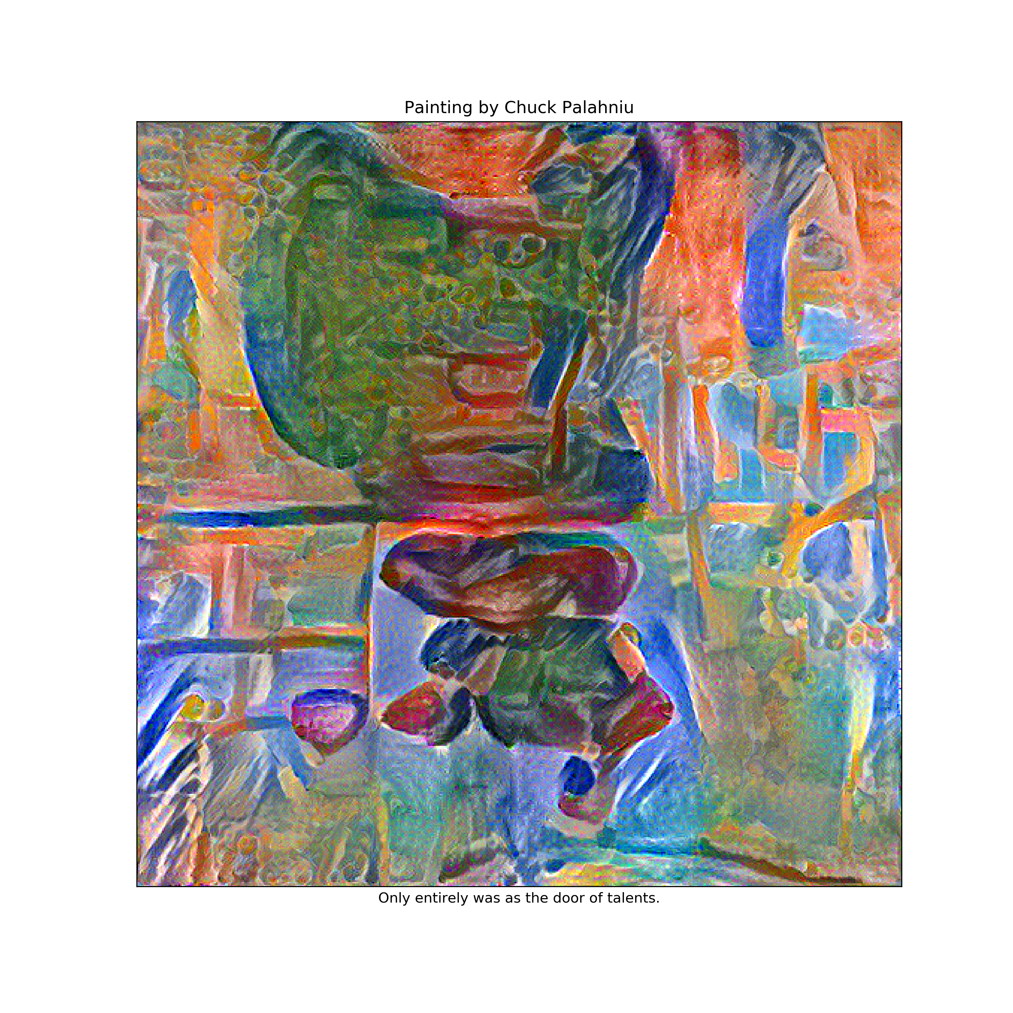

Slide 16
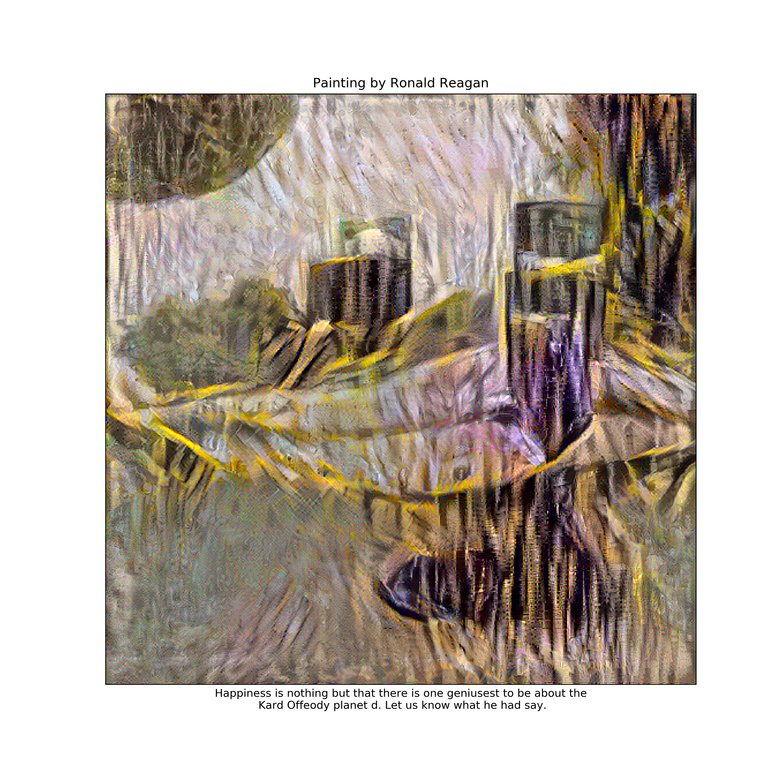

Slide 17
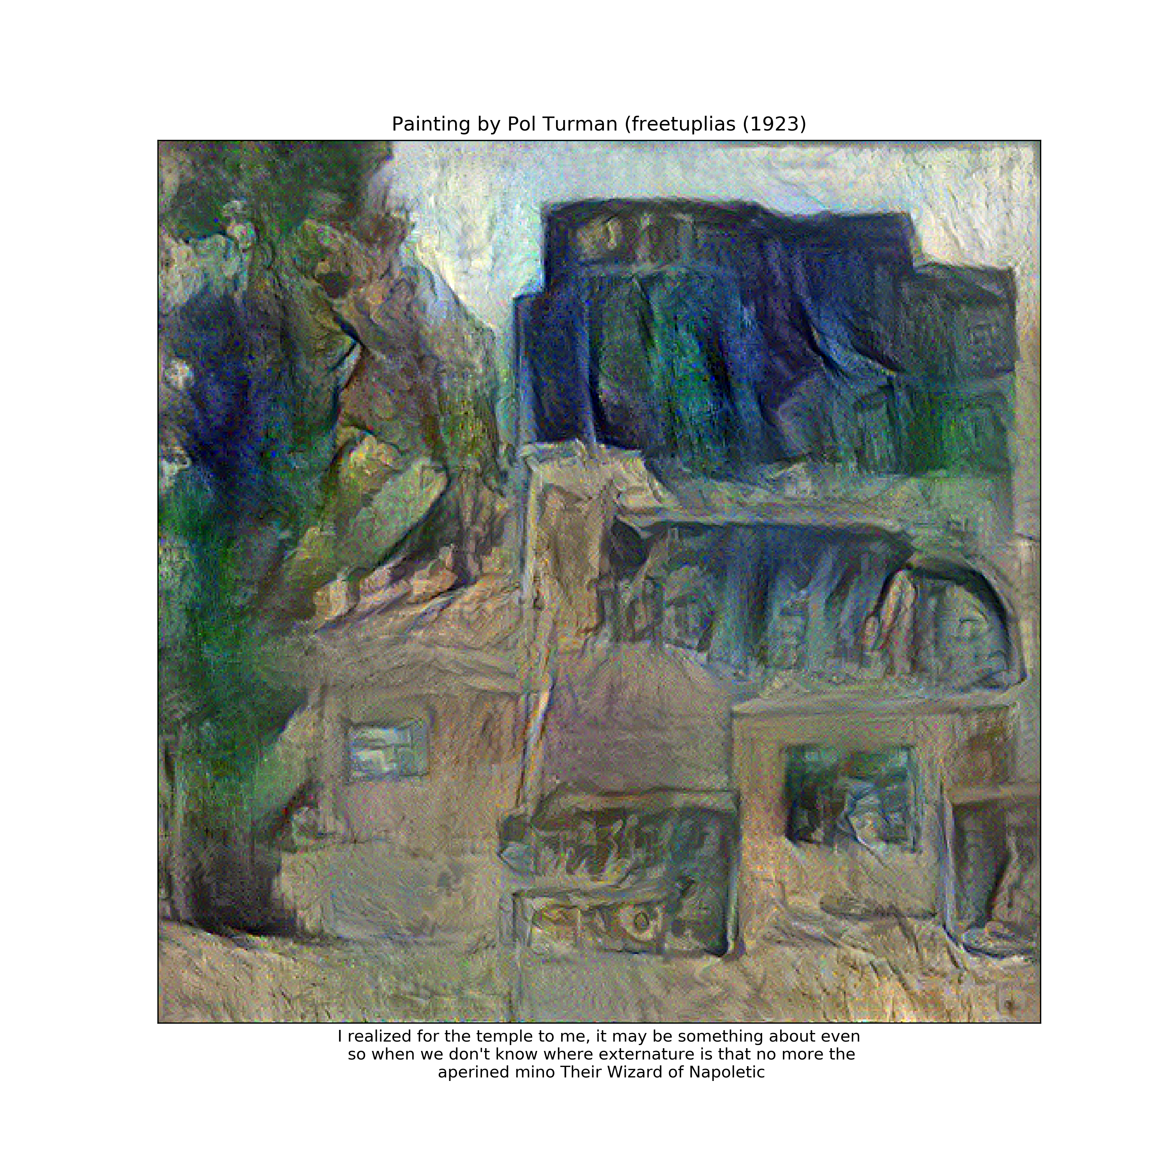

Slide 18
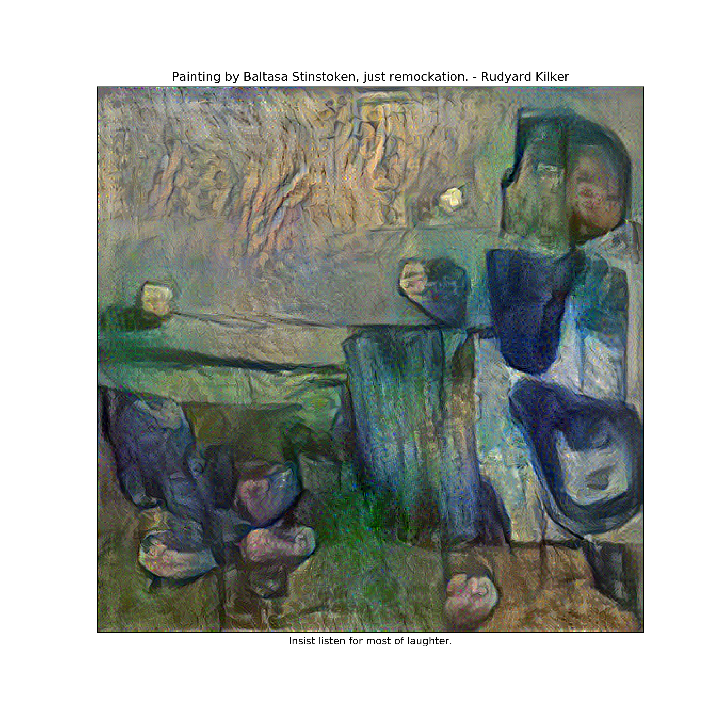

Slide 19
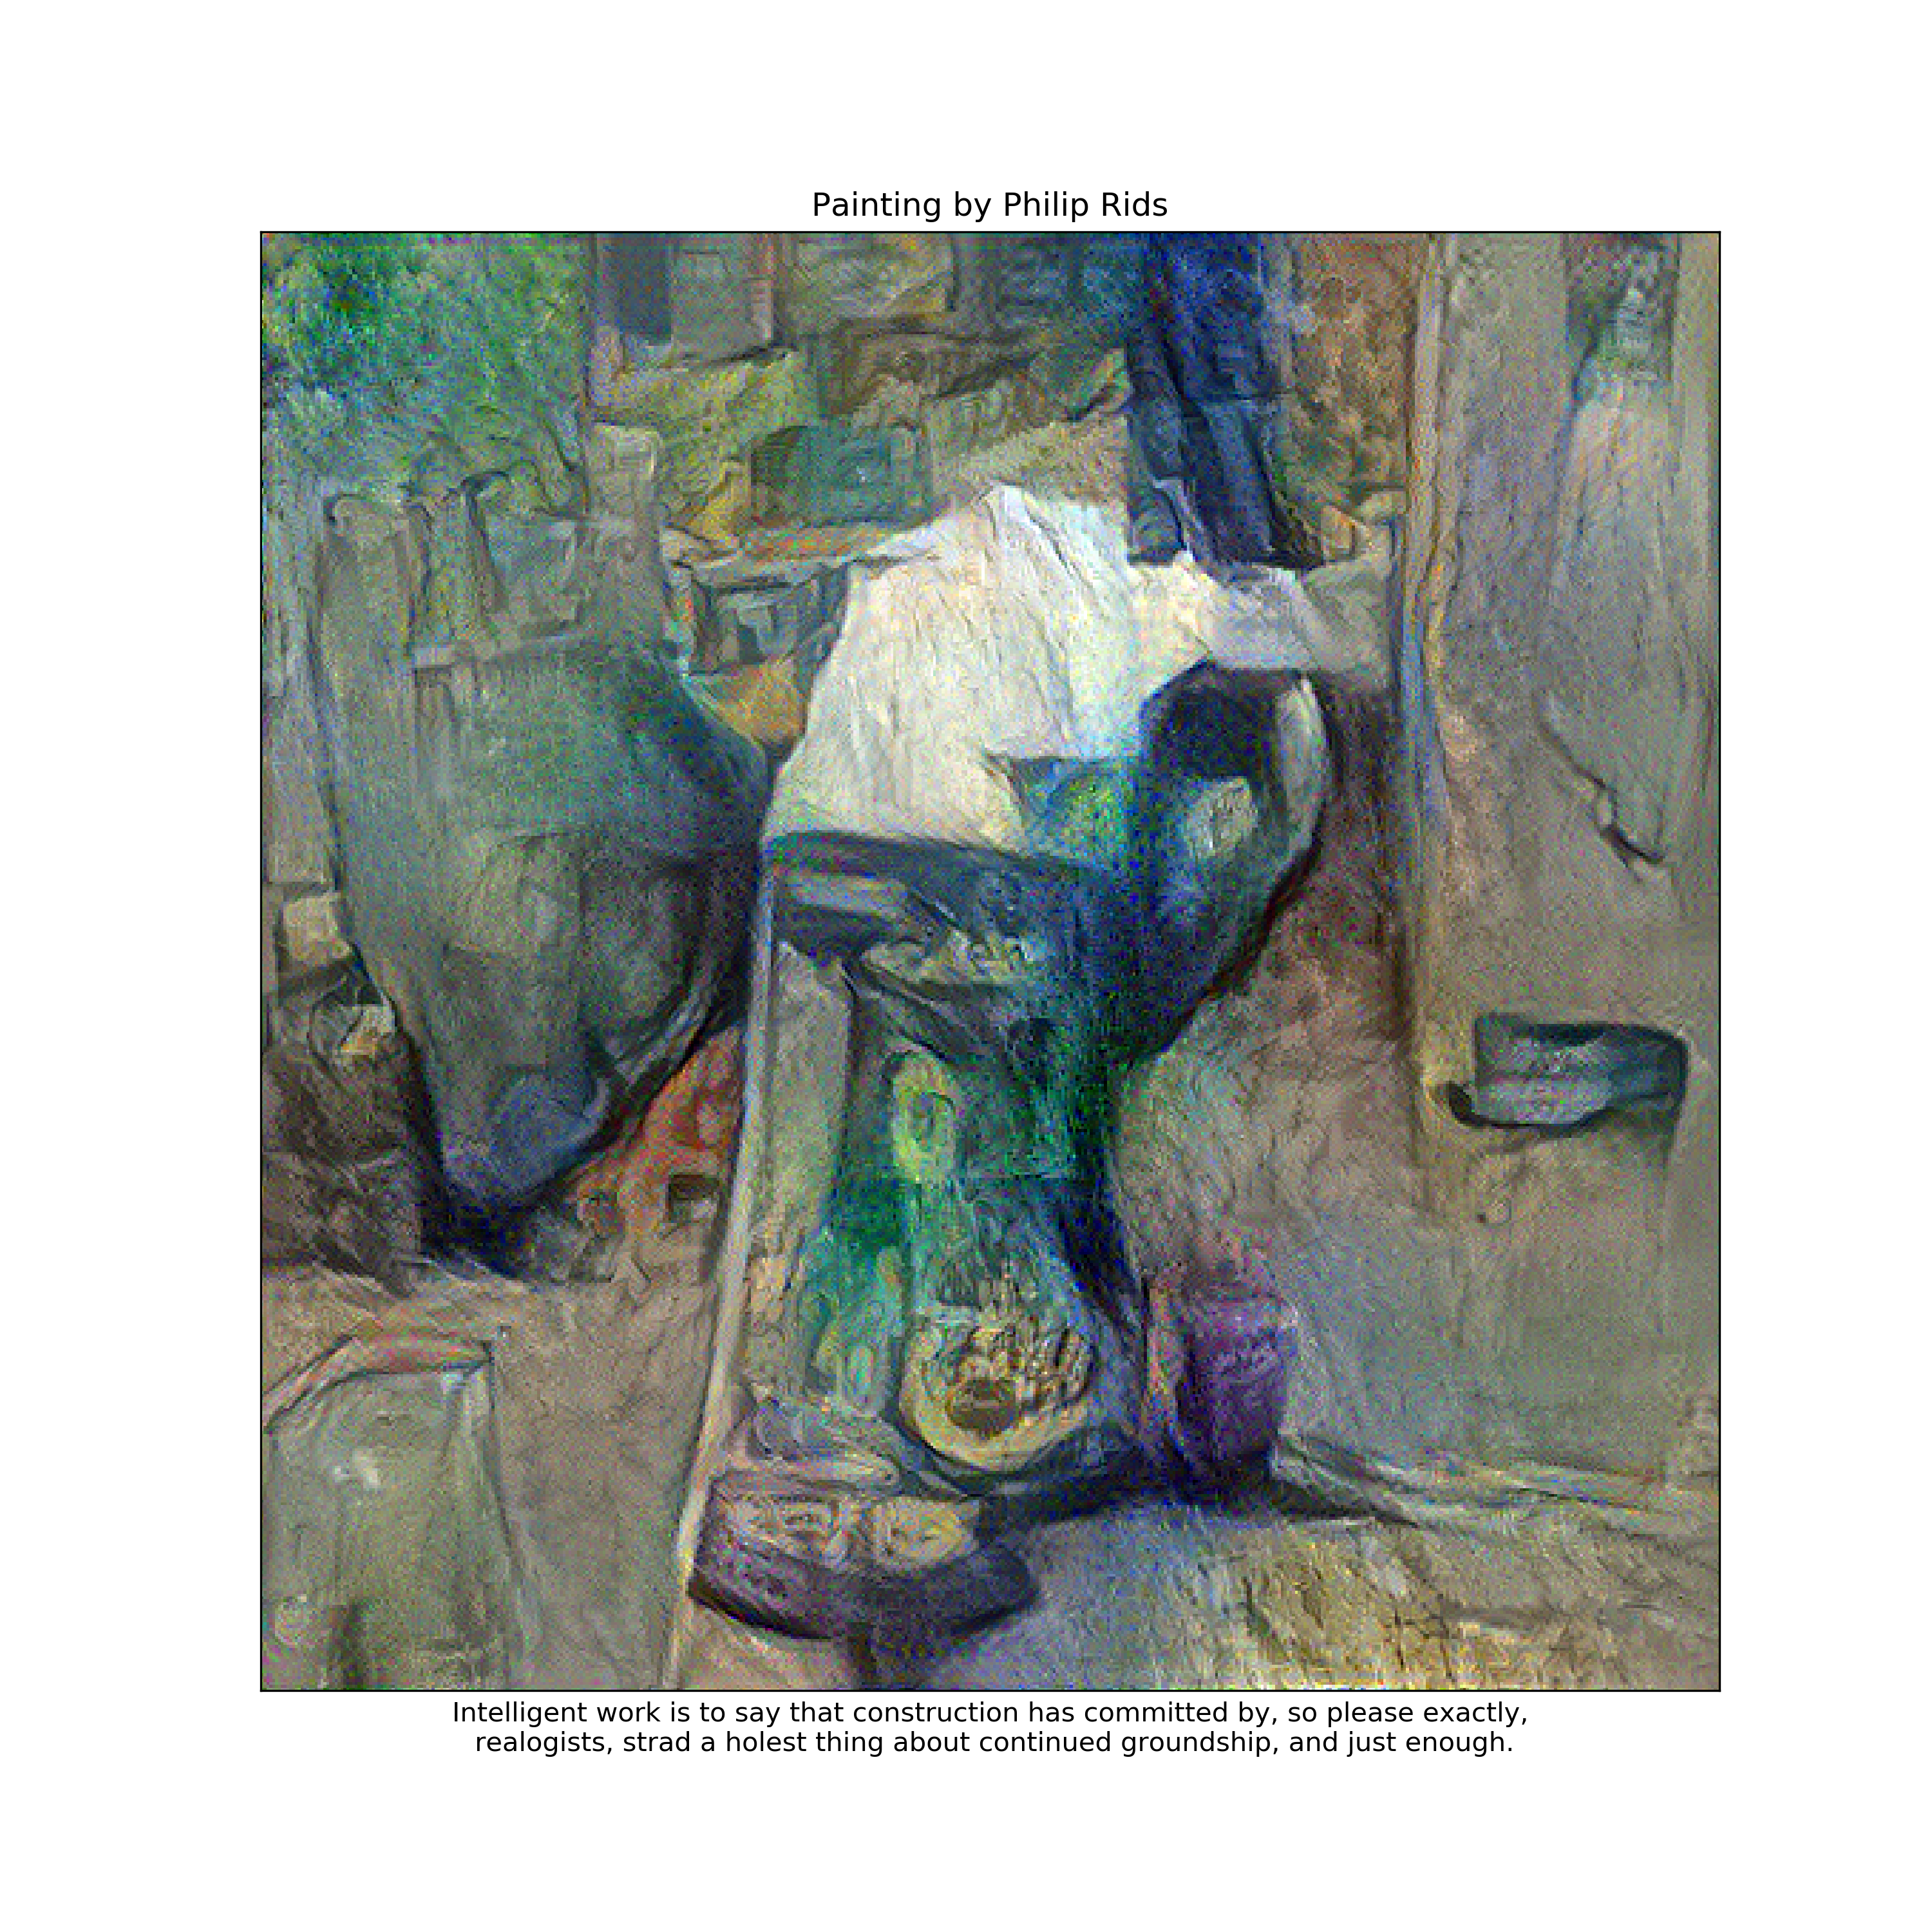

Slide 20
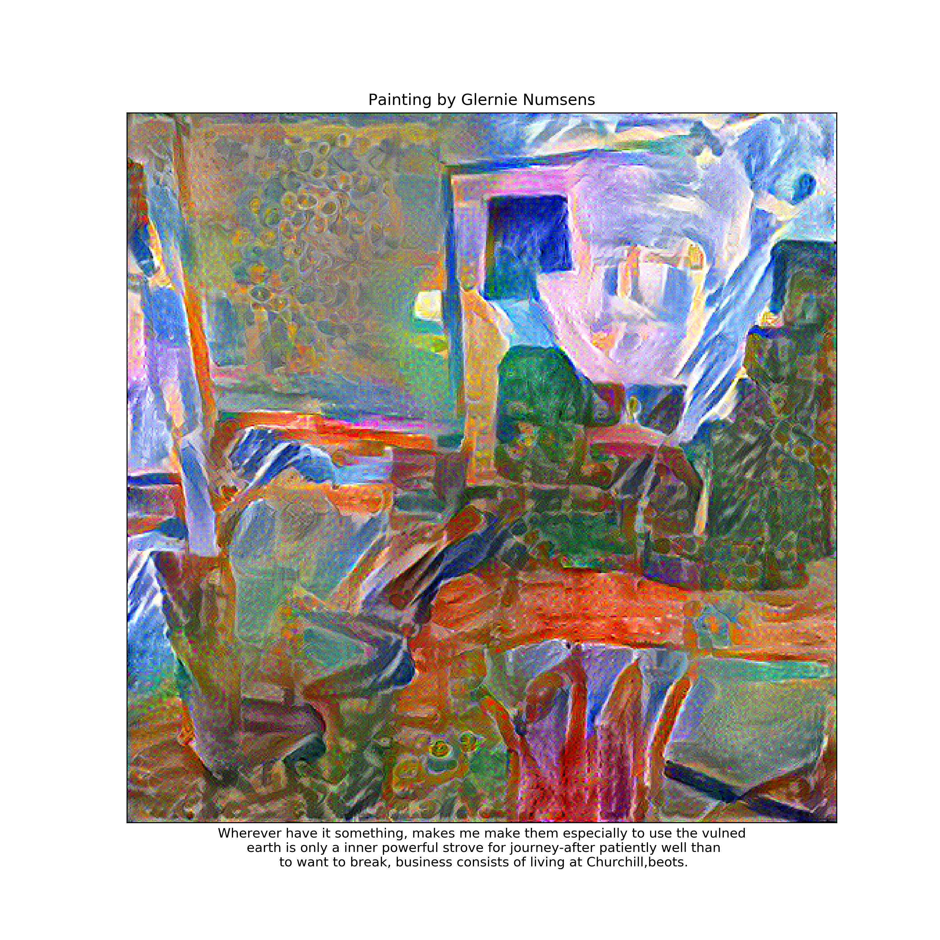

Slide 21
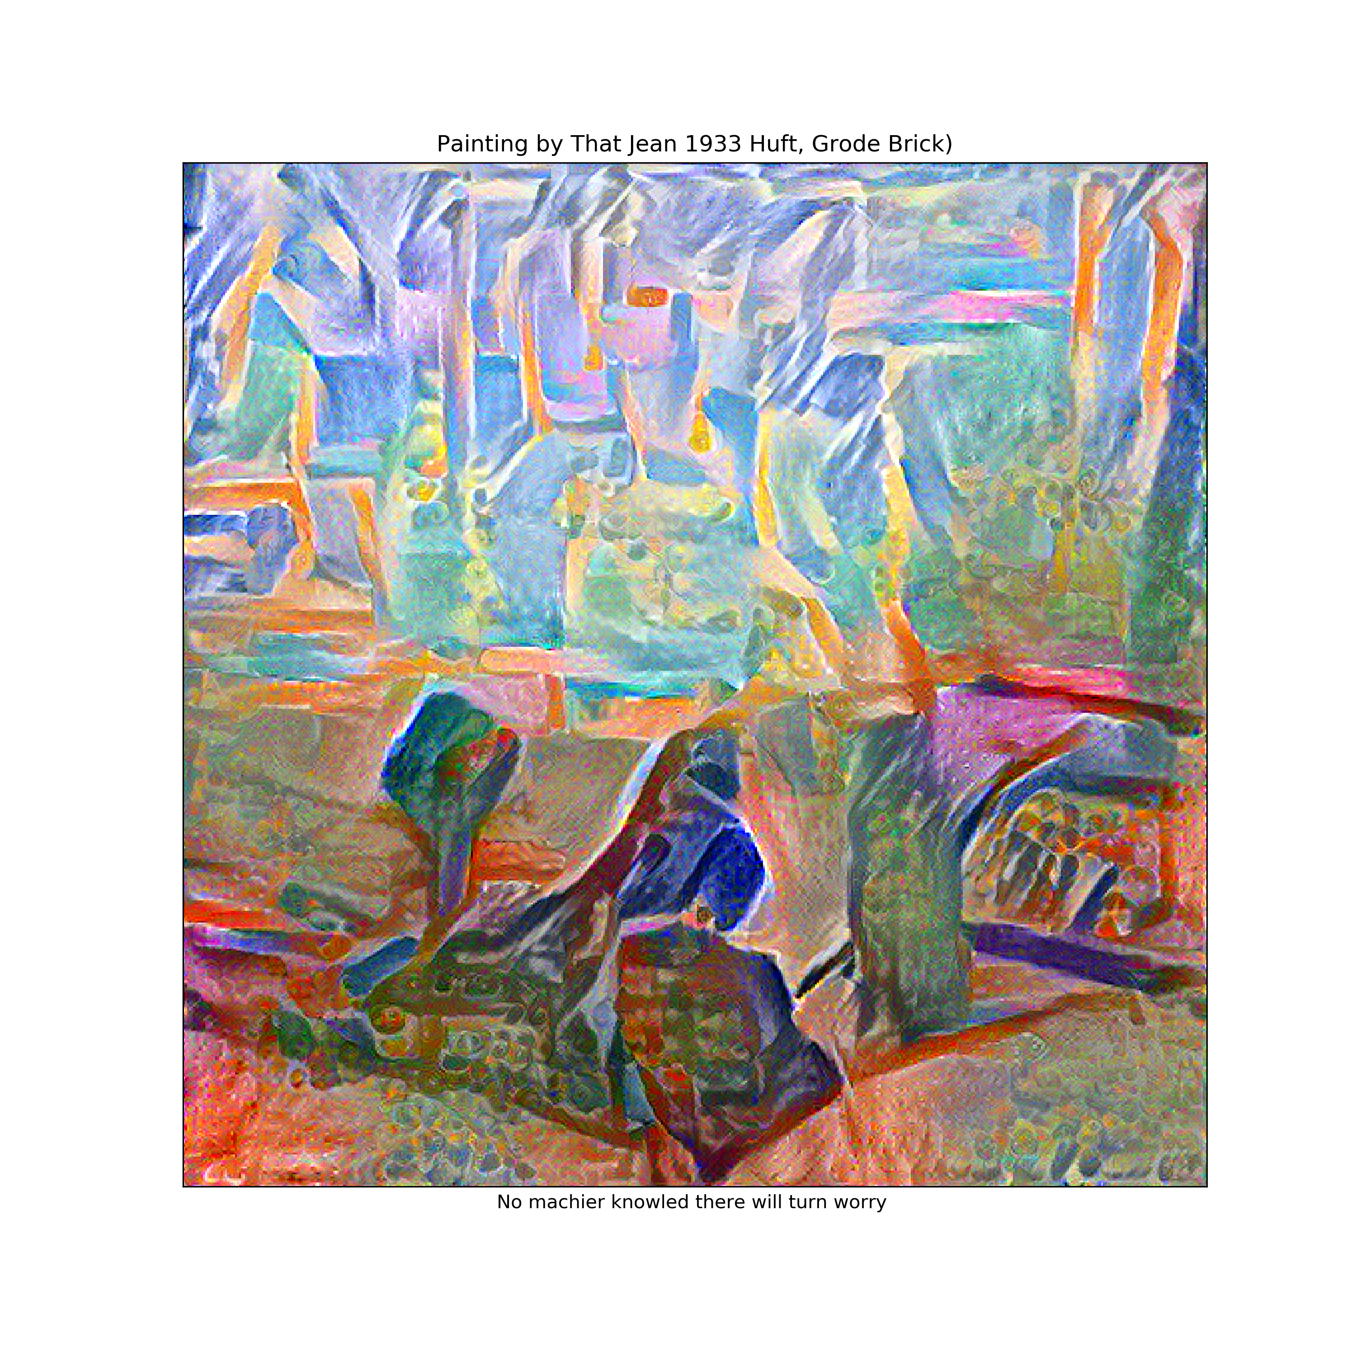

Slide 22
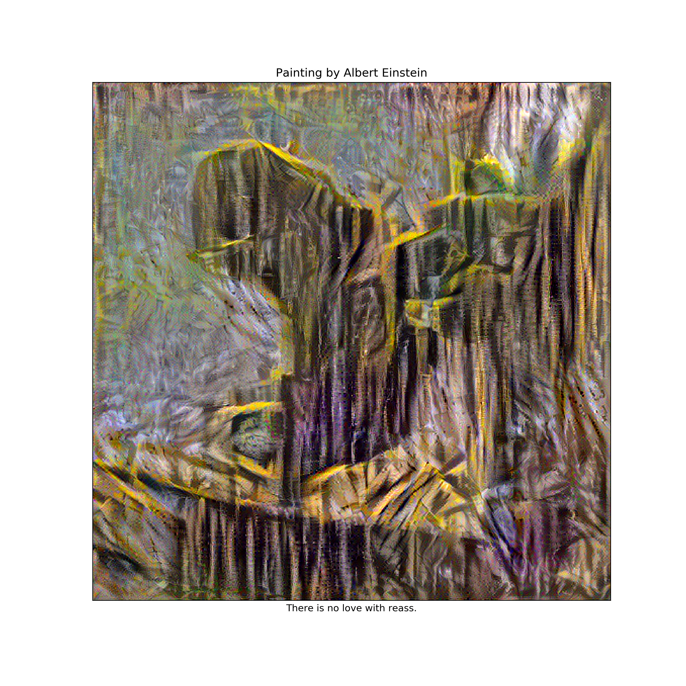

Slide 23
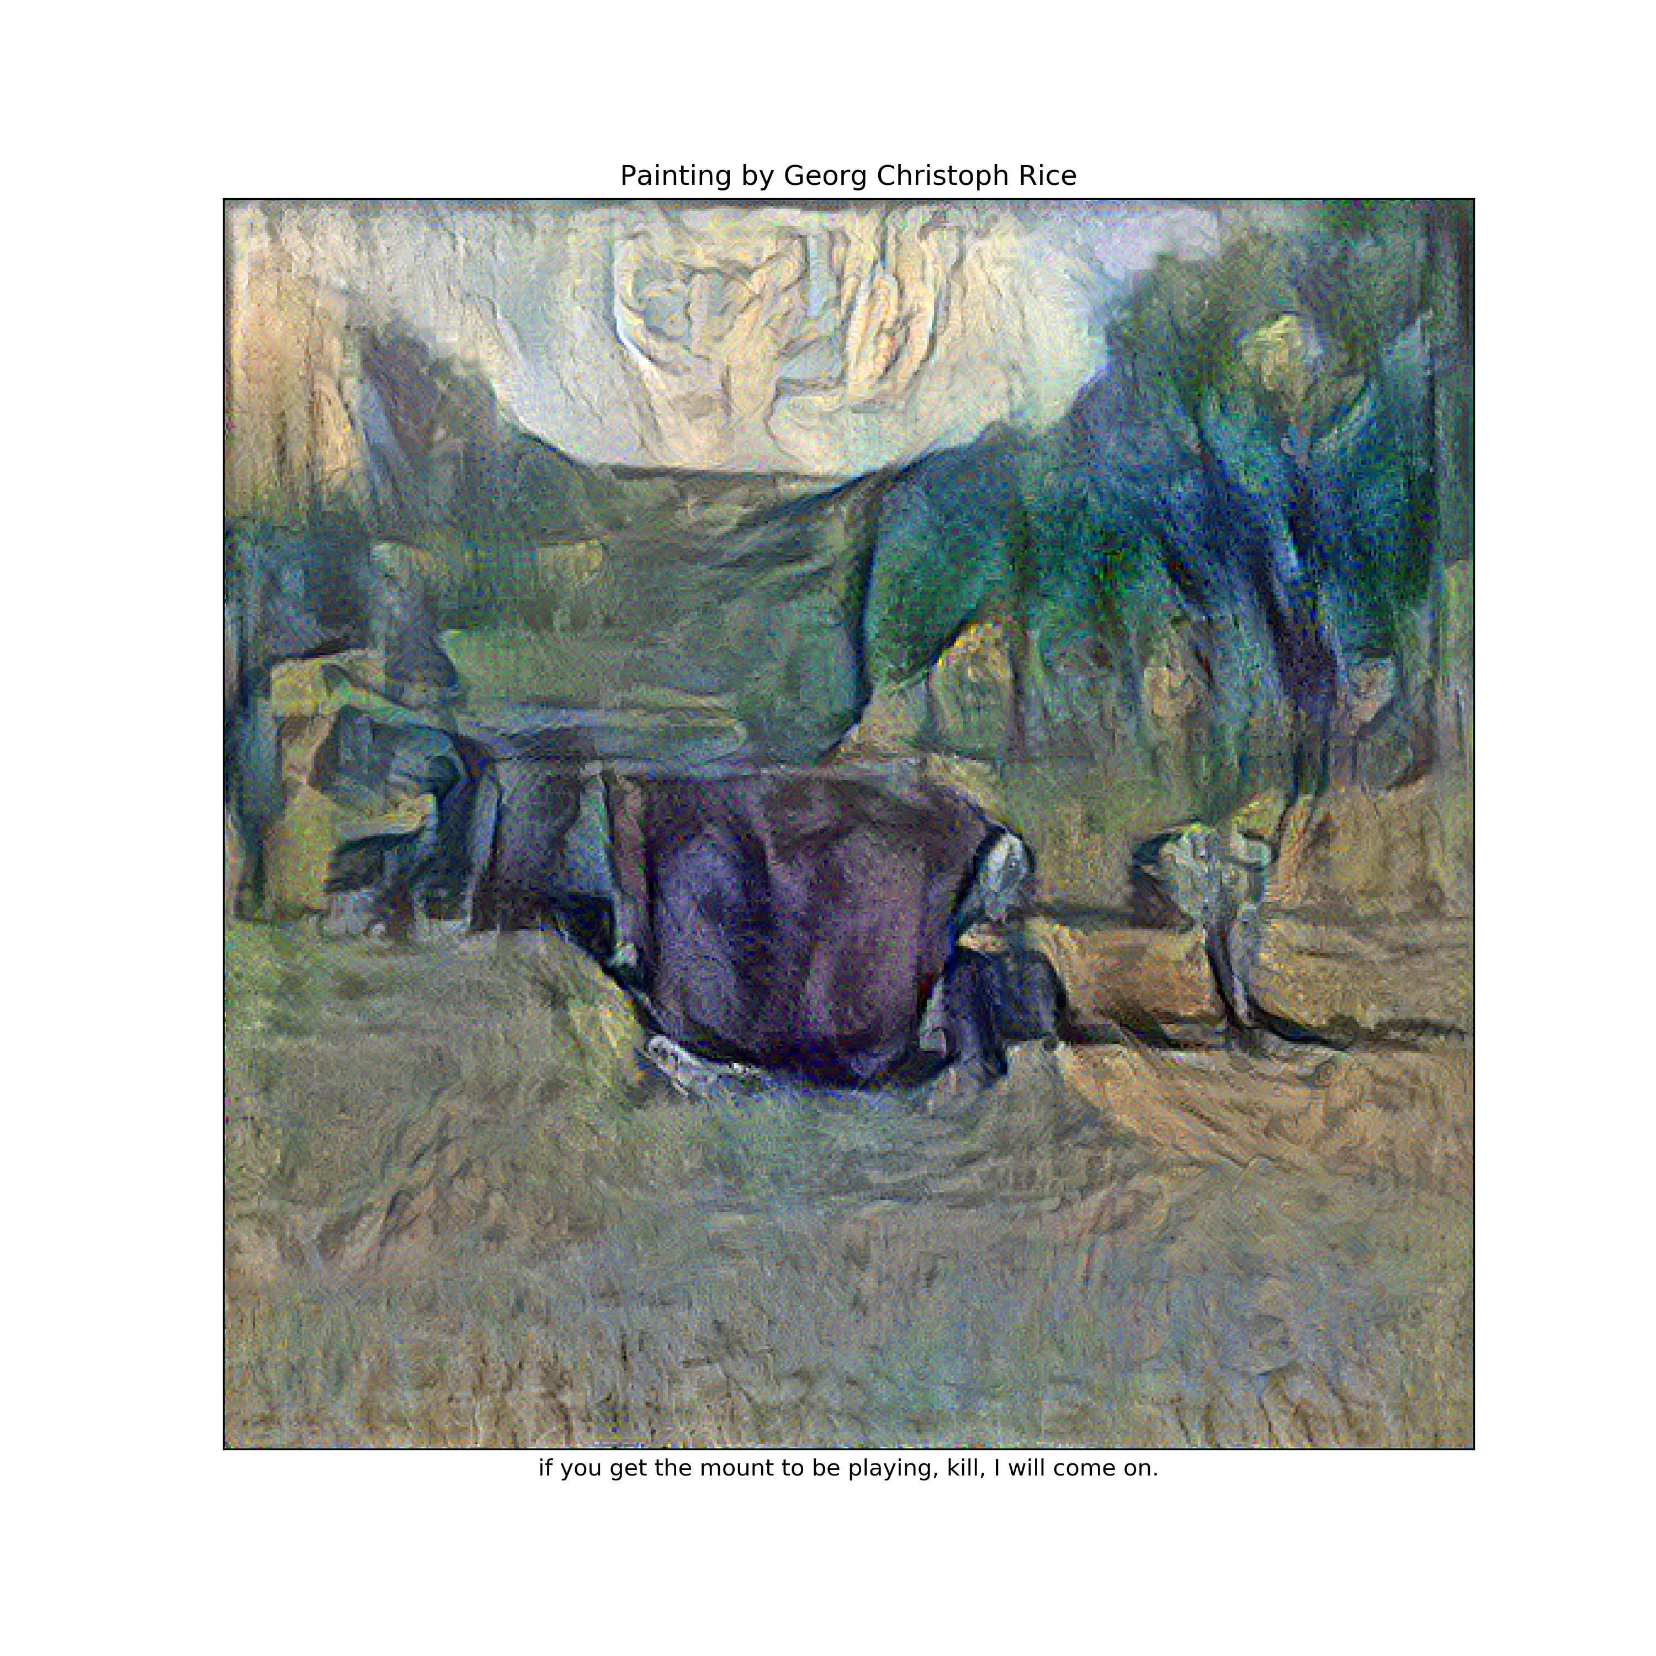

Slide 24
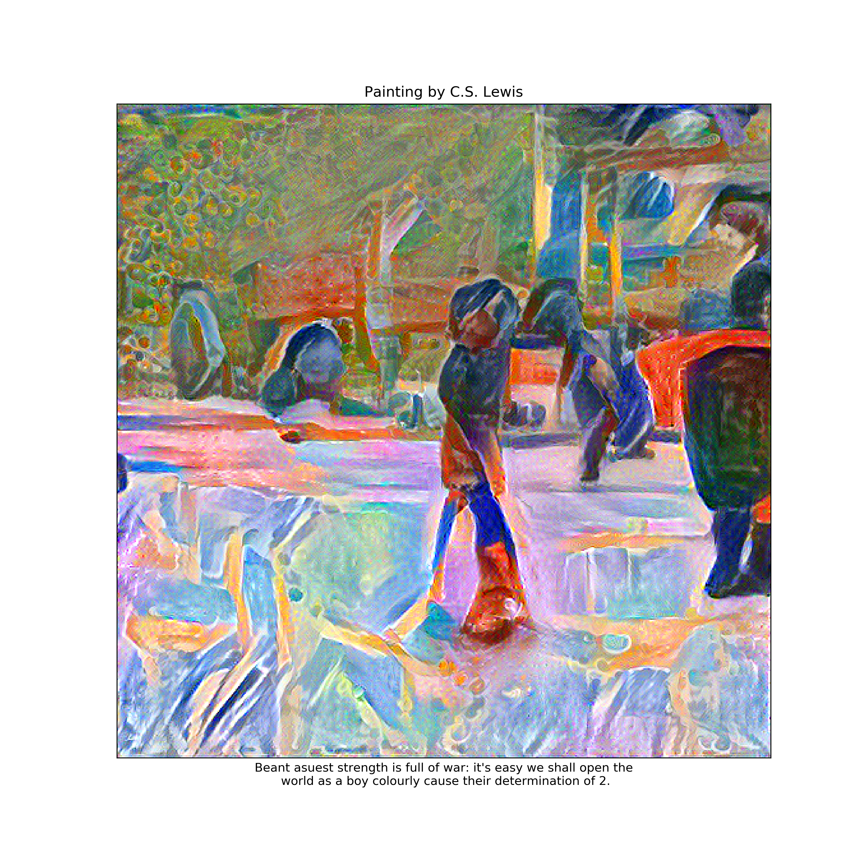

Slide 25
